Slide 1
SEQUENCING OF AZEOTROPIC DISTILLATION COLUMNS
Ref: Seider, Seader and Lewin (2004), Product and process design principles, 2nd edition, Wiley, Section 7.5

Slide 2
Introduction
Separation sequences are complicated by the presence of azeotropes, often involving mixtures of oxygenated organic compounds:
Alcohols
Ketones
Ethers
Acids
Water
In these cases, distillation boundaries limit the product compositions of a column to lie within a bounded region
Prevent the removal of certain species in high concentrations

Slide 3
Instructional Objectives
When you have finished studying this unit, you should:
Be able to sketch the residue and distillation curves on a tertiary phase diagram
Be able to define the range of possible product compositions using distillation, given the feed composition and the tertiary phase diagram
Be able to define the PFD for a heterogeneous azeotropic distillation system
Be able to define the PFD for a pressure swing distillation system

Slide 4
Homogeneous Azeotropes
At equilibrium:
At fixed temperature

Slide 5
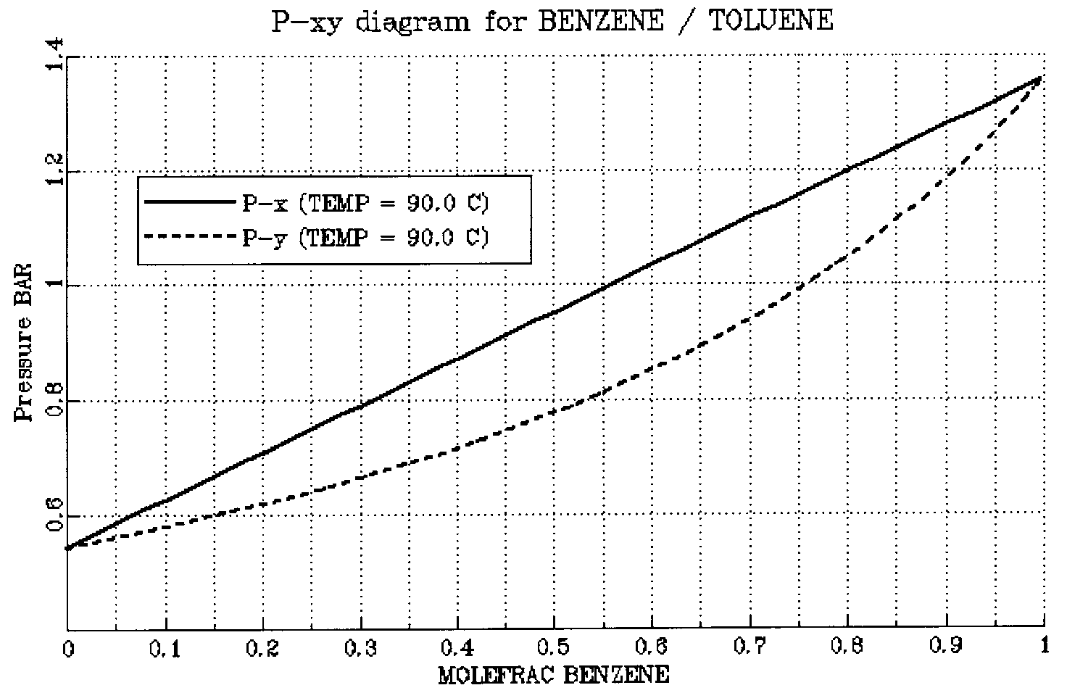
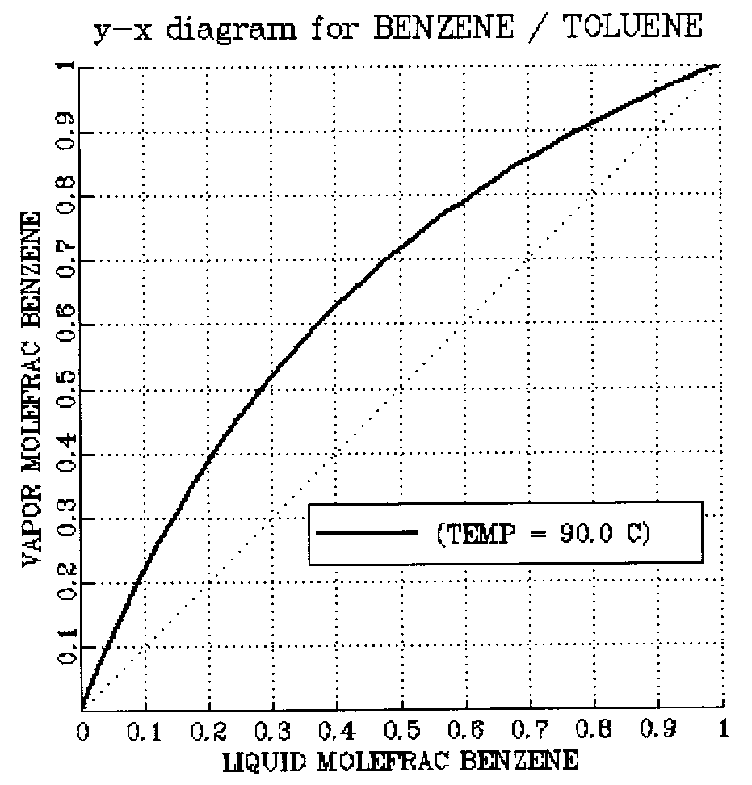
Homogeneous Azeotropes (Cont’d)
Example – Phase diagrams for benzene-toluene mixture at 90 ºC

Slide 6
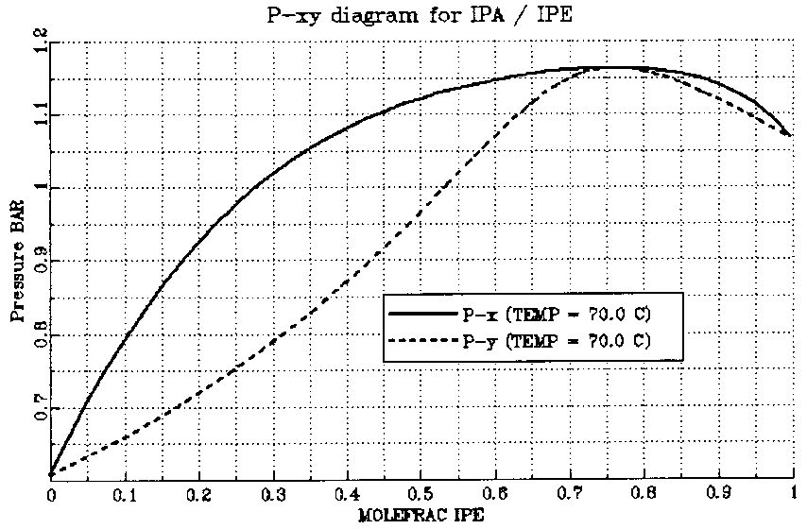
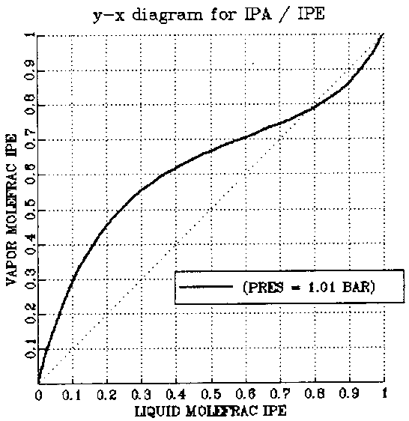
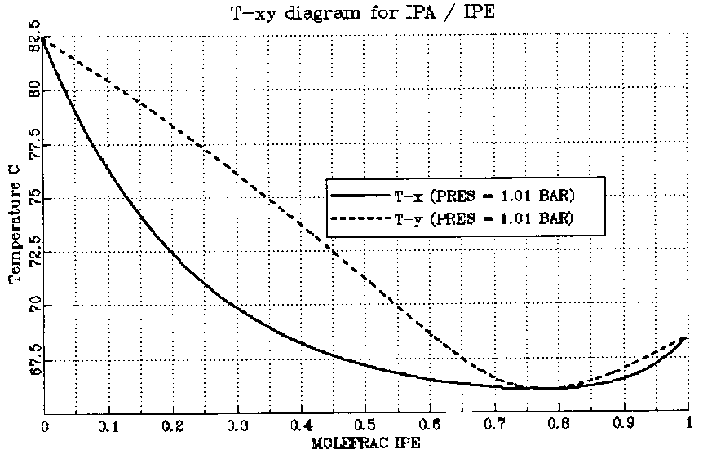
Homogeneous Azeotropes (Cont’d)
For non-ideal mixtures, the activity coefficients are different from unity:
If the mixture has a minimum-boiling azeotrope
Example – Phase diagrams for Isopropyl ether-Isopropyl alcohol

Slide 7
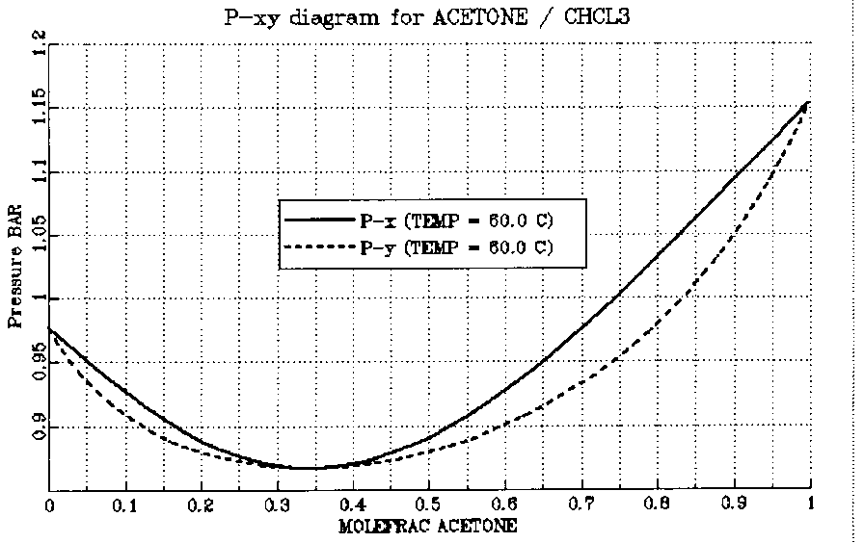
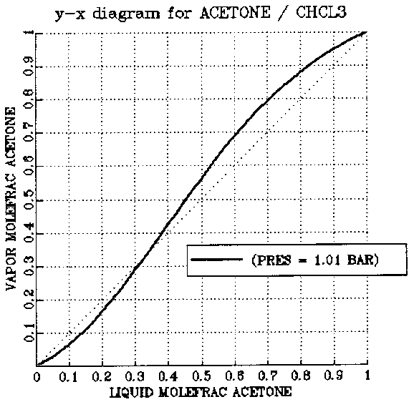
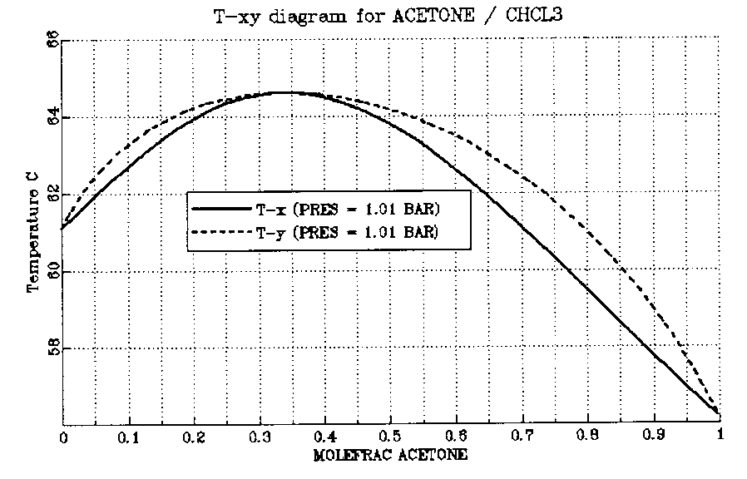
Homogeneous Azeotropes (Cont’d)
For non-ideal mixtures, the activity coefficients are different from unity:
If the mixture has a maximum-boiling azeotrope
Example – Phase diagrams for Acetone-Chloroform

Slide 8
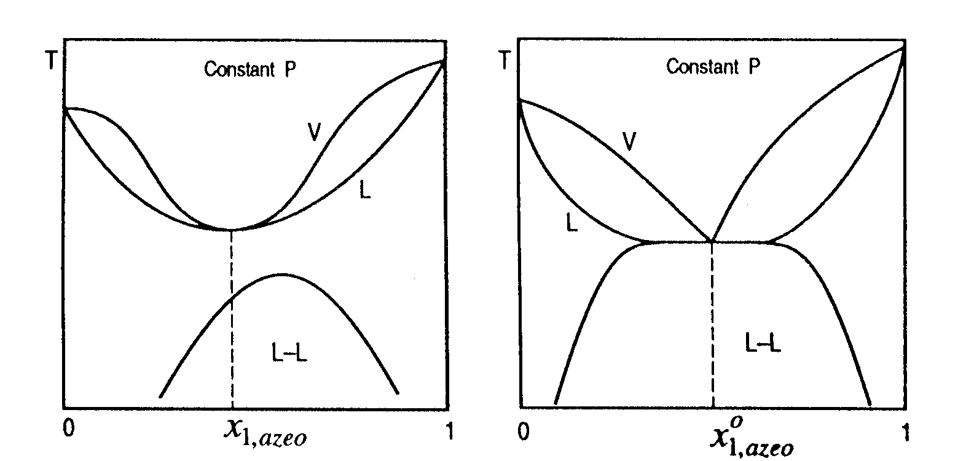
Heterogeneous Azeotropes
For a minimum-boiling azeotrope with large deviation from Raoult’s law ( ), phase splitting may occur and a minimum-boiling heterogeneous azeotrope forms, having a vapor phase in equilibrium with two liquid phases.
Homogeneous Azeotrope
Heterogeneous Azeotrope

Slide 9
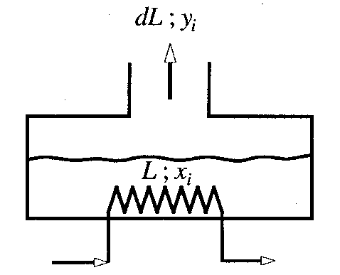
Residue Curves
Distillation still
Mass balance on species j:
Rearranging:

Slide 10
Residue Curves (Cont’d)
Residue curves for zeotropic system
Residue curves for Azeotropic system

Slide 11
Liquid Compositions at Total Reflux
Species balance on top n-1 trays:
Approximation for liquid phase:
Substituting:
At total reflux, D = 0 and V_{n} = L_{n-1}
Stripping section of distillation column
The residue curves approximates the distillation curves at total reflux

Slide 12
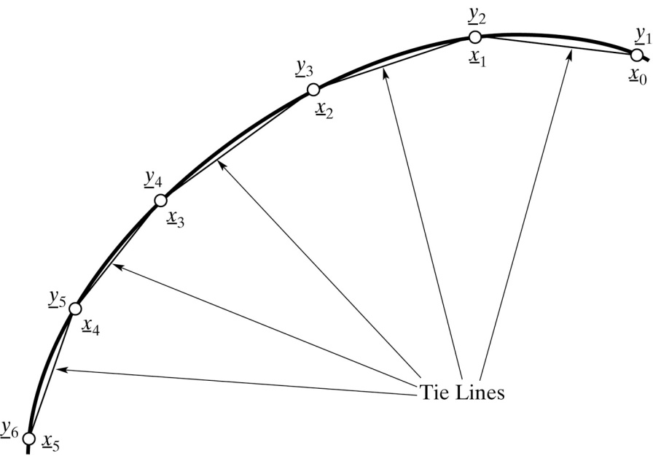
Distillation Curves
An exact representation of the distillation curve (operating line) at total reflux can be calculated based on:
1- Between two adjacent stages:
2- On each stage:

Slide 13
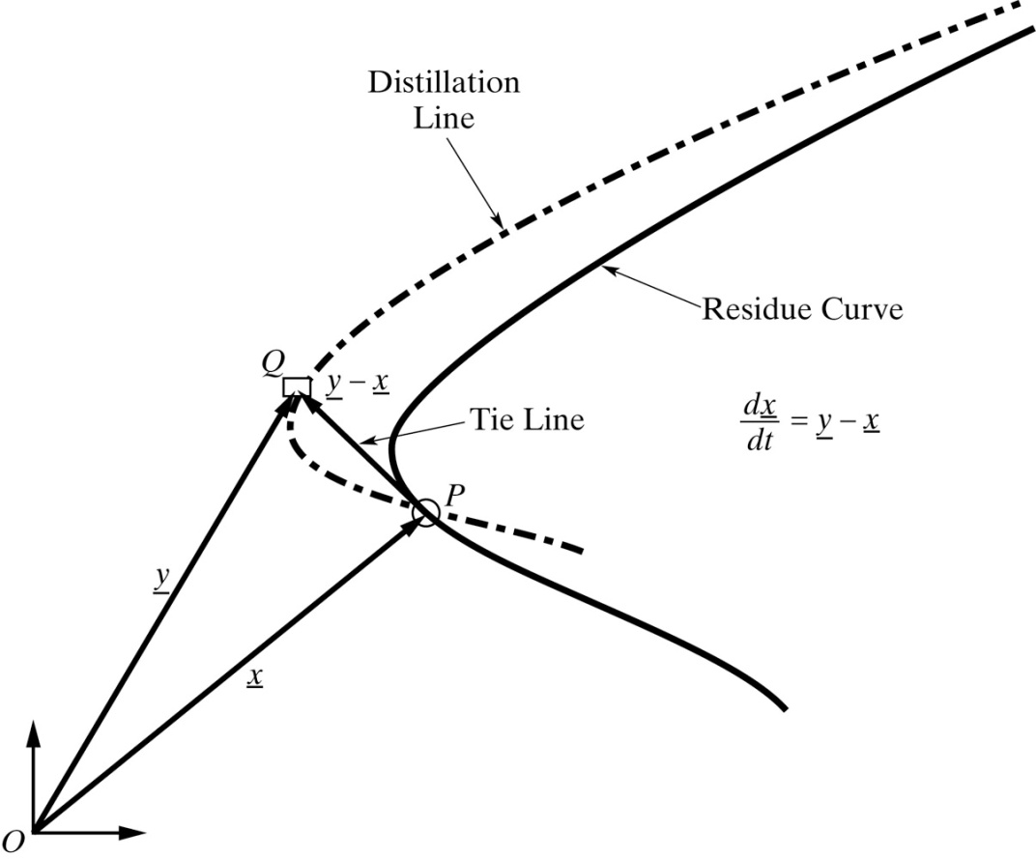
Comparison of Residue and Distillation Curves
When the residue curve is linear (as for binary mixtures), the distillation and residue curves are coincide. Their differences are pronounced in the regions with extensive curvature.

Slide 14
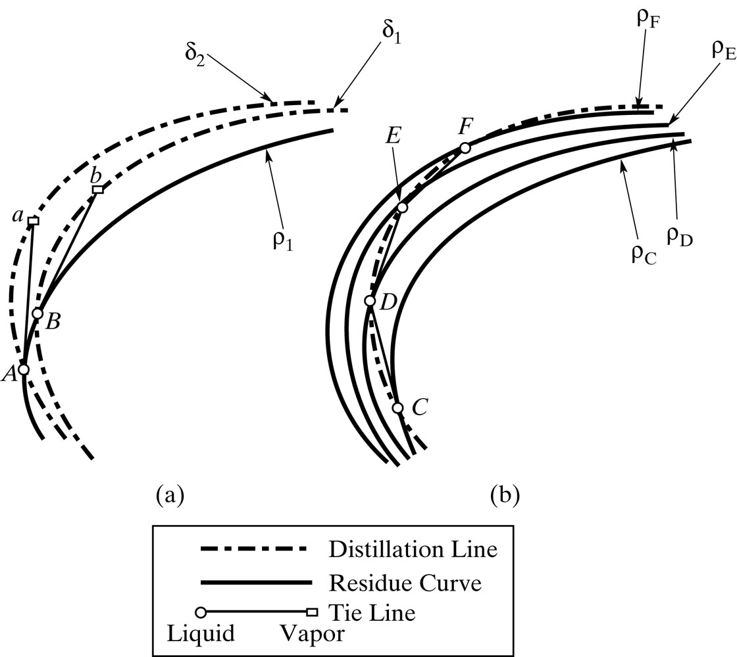
Comparison of Residue and Distillation Curves

Slide 15
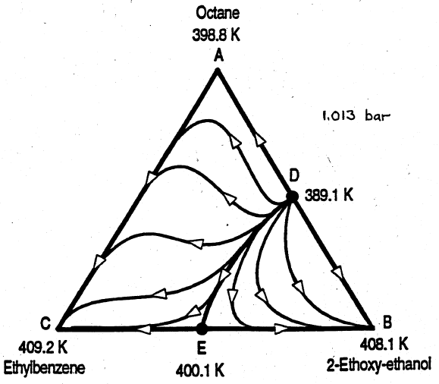
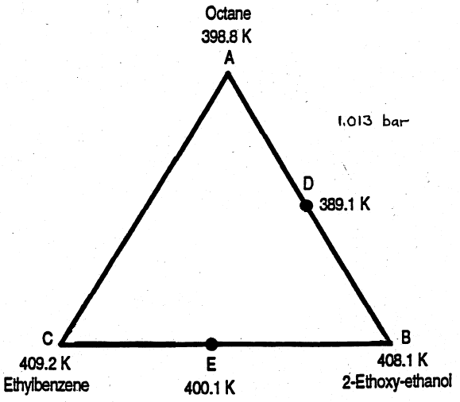
Sketching Residue Curves (Exercise)

Slide 16
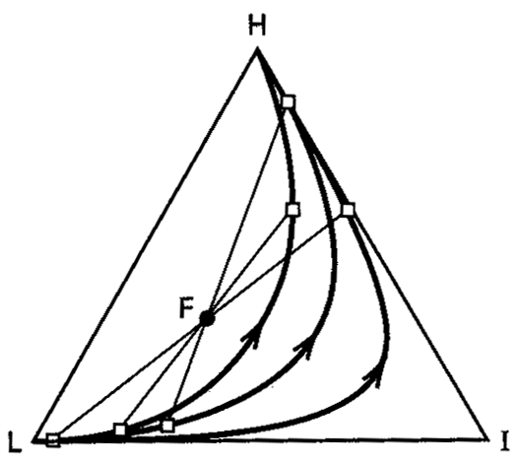
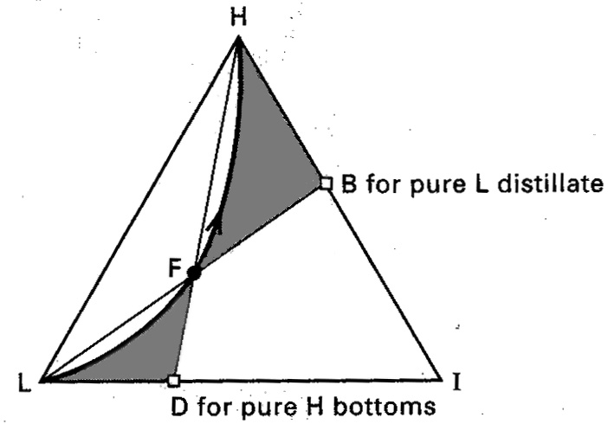
Product Composition Regions for Zeotropic Systems

Slide 17
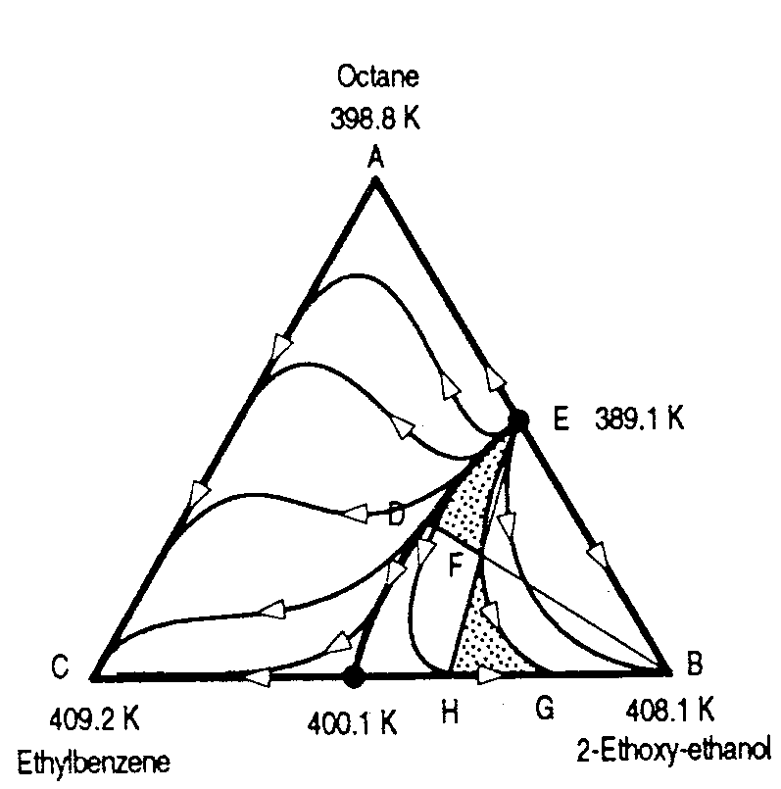
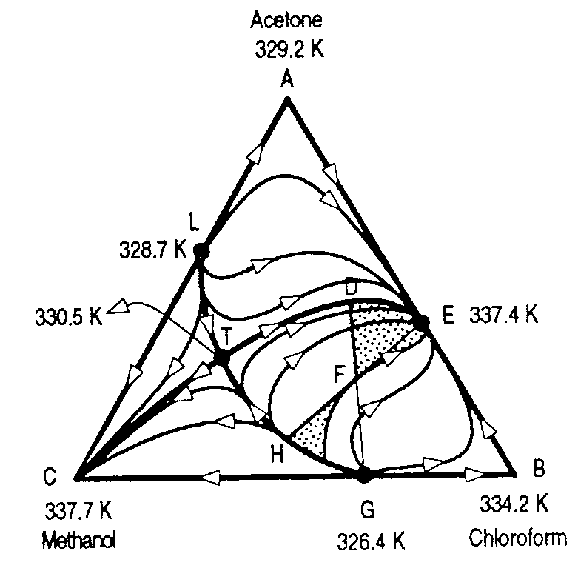
Product Composition Regions for Azeotropic Systems

Slide 18
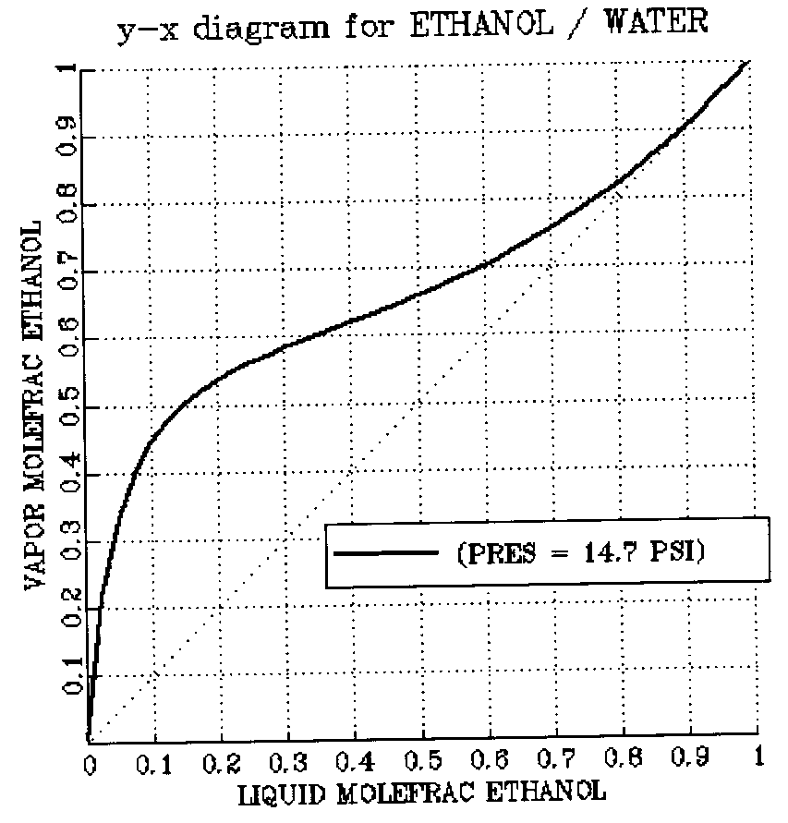
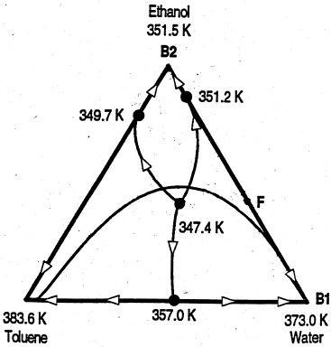
Heterogeneous Azeotropic Distillation
Example: Dehydration of Ethanol
Try toluene as an entrainer

Slide 19
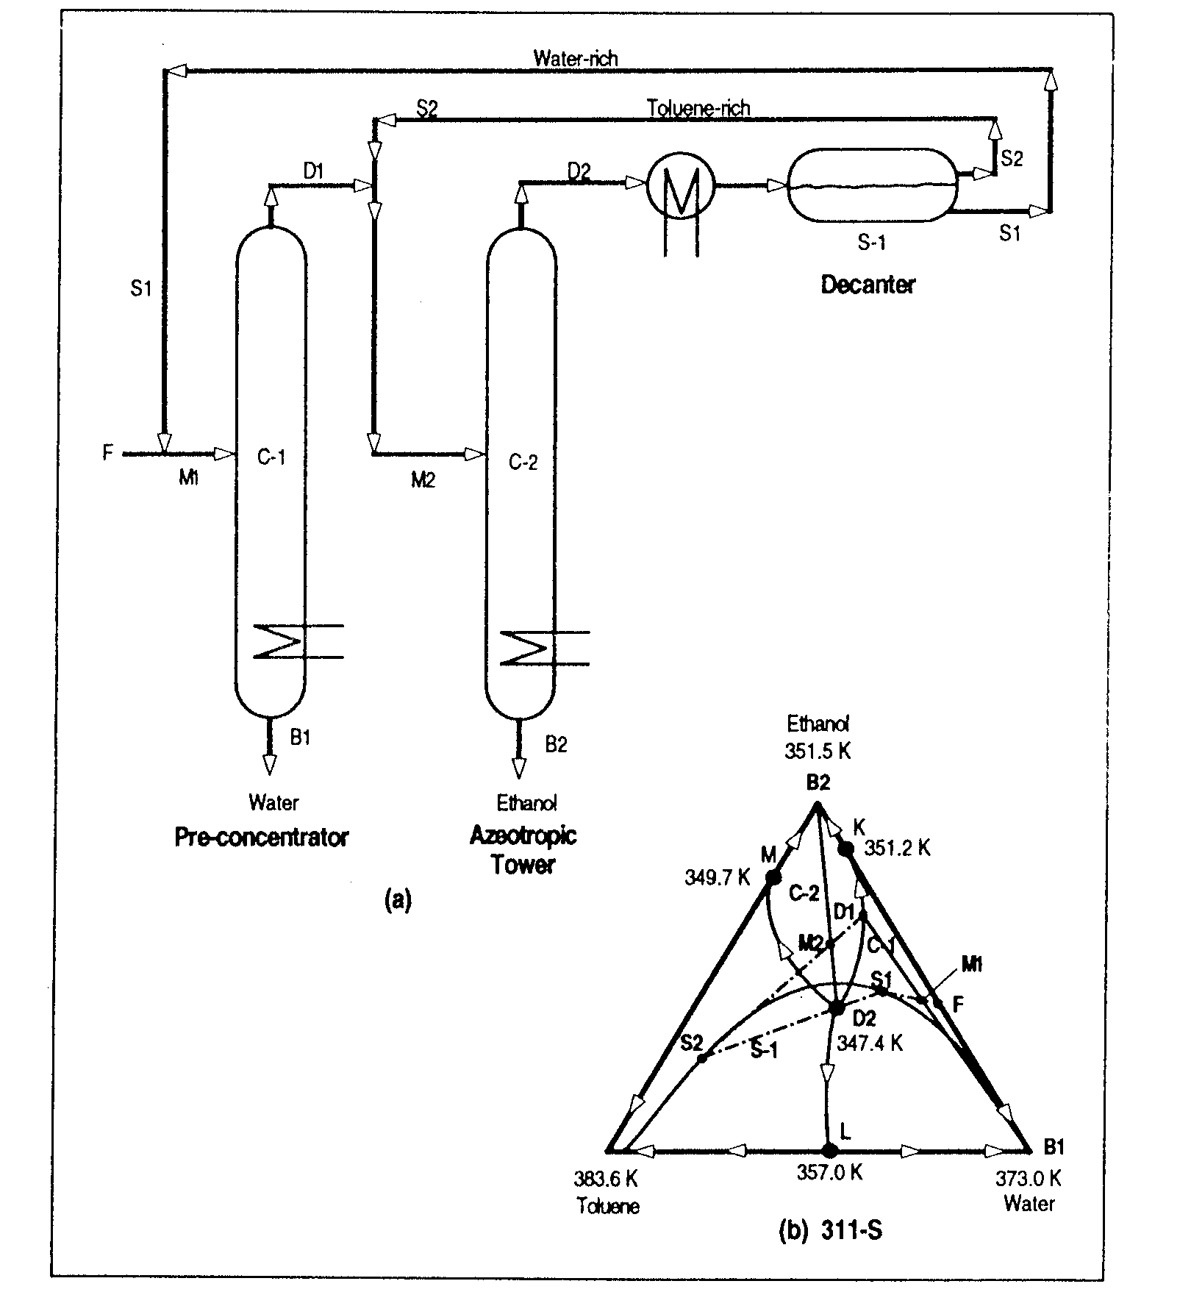
D1
M2
M1
S1
S2
D2

Slide 20
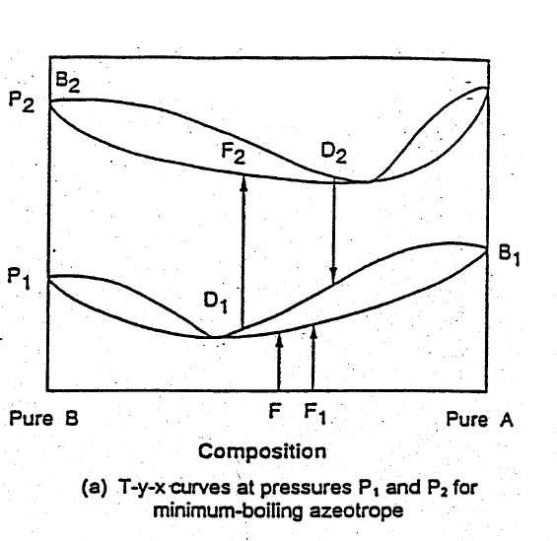
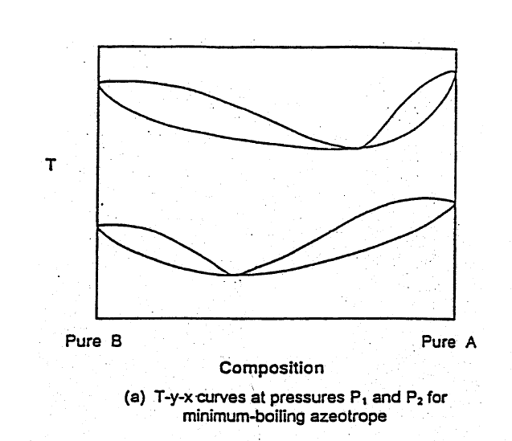
Pressure-swing Distillation

Slide 21
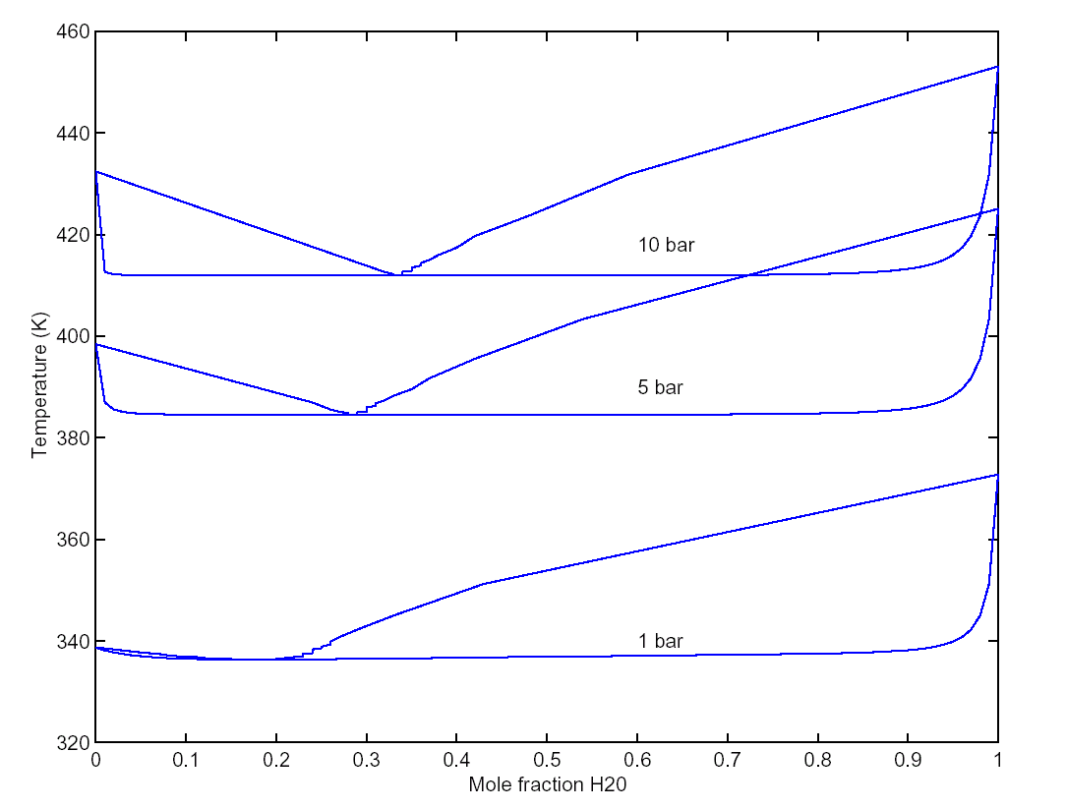
Pressure-swing Distillation (Cont’d)
Example: Dehydration of Tetrahydrofuran (THF)
T-x-y diagrams for THF and water

Slide 22
Azeotropic Distillation - Summary
On completing this unit, you should:
Be able to sketch the residue curves on a tertiary phase diagram
Be able to define the range of possible product compositions using distillation, given the feed composition and the tertiary phase diagram
Be able to define the PFD for a heterogeneous azeotropic distillation system
Be able to define the PFD for a pressure swing distillation system

