Slide 1
Column Internals
Trays
Ref. 1: HAT International, “Alpha Tray Design Sheet”, www.hatltd.com
Ref. 2: W. Solken, “Distillation Columns: Column Internals”, www.wermac.org
Ref. 3: Aspen Plus Online Help, ASPEN ONE V10, AspenTech INC.

Slide 2
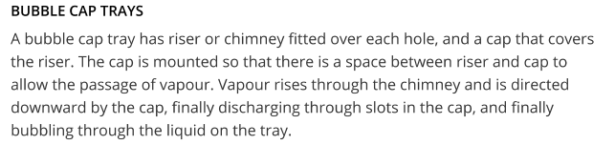
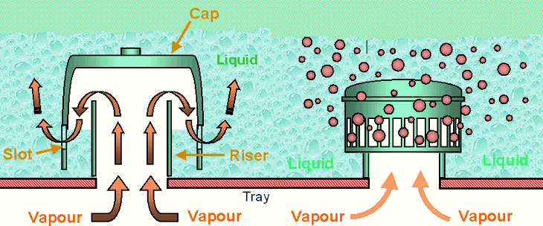
Trays Types
There are three types of cross-flow trays: (1) sieve, (2) valve and (3) bubble cap.

Slide 3
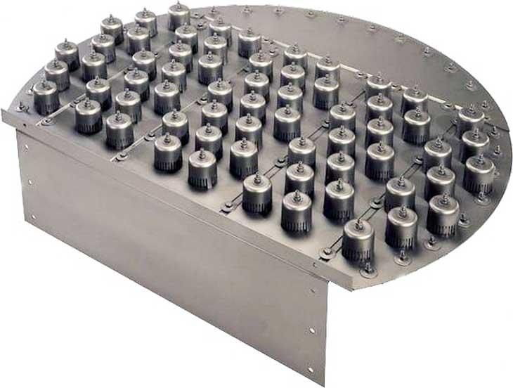
Trays Types

Slide 4
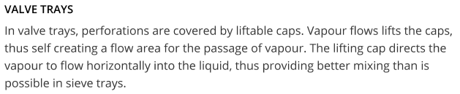
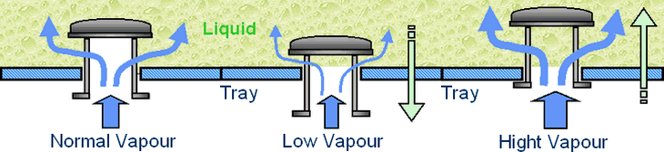
Trays Types

Slide 5
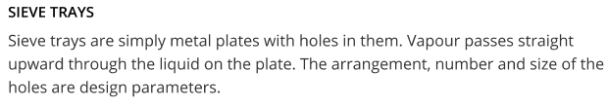
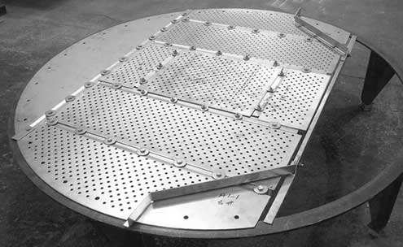
Trays Types

Slide 6
Comparing Trays Performance
The principle factors in comparing the performance of trays are:
Cost: Bubble-caps are appreciably more expensive than sieve or valve trays. Due to its simple design, sieve trays are normally the cheapest. (Rel. Cost: 1.0 sieve, 1.2 valve, 2.0 bubble-cap)
Turndown Ratio: The ratio of the highest to the lowest flowrates of vapor over which the tray will operate satisfactorily. Bubble-cap trays have the highest turndown ratio, followed by valve tray (up to 10), and sieve tray (up to 2).

Slide 7
Comparing Trays Performance
Pressure Drop: The tray pressure drop will depend on the detailed design of the tray, but in general, sieve trays give the lowest pressure drop, followed by valves, and bubble-caps.
Maintenance: For dirty services, bubble-caps are not suitable as they are most susceptible to plugging. Sieve trays are the easiest to clean.

Slide 8
Trays Operation Limits
Jet Flood is the criteria used to predict the point at which massive liquid carryover will occur due to the height of spray on the tray deck exceeding the available tray space.
It is normal practice to limit tray design to a maximum of 80% of jet flood to allow a safety margin on tower control, possible discrepancies of VLE data and also the limitations of the flooding correlation used.

Slide 9
Trays Operation Limits
Entrainment Limit is reached when the velocity of vapor through the tray open area is high enough to project liquid droplets to the tray above.
Weeping occurs when the velocity of the vapor through the tray open area is too low to prevent liquid from leaking through the open area thus by-passing contact area to the tray below. Most valve and sieve trays will weep in normal operation (less than 10%).

Slide 10
Trays Operation Limits
Blowing Flood occurs at low liquid rates at which the tray operates in the spray regime resulting in massive entrainment of liquid to the tray above to the extent that the tray deck is essentially blown dry.
Downcomer Choke Flood occurs at high liquid loads when the downcomers are too small to allow effective vapor disengagement causing vapor entrainment to the tray below.

Slide 11
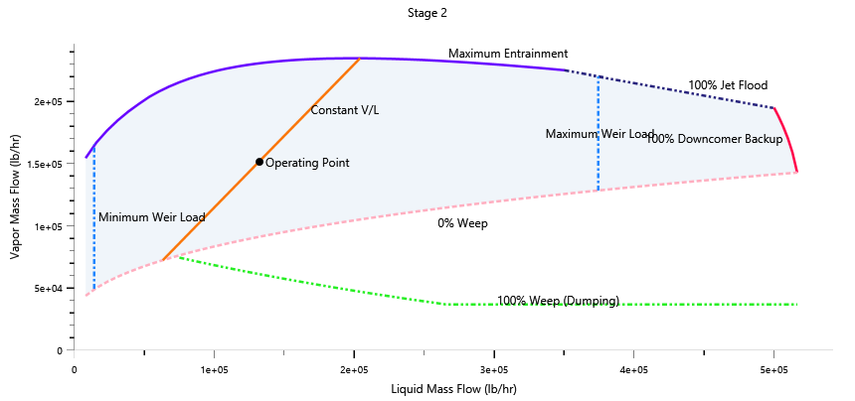
Trays Operation Limits
Downcomer Back-up occurs when the head of liquid (aerated) in the downcomer backs up onto the tray deck.
Other operation limits that may be used are: Minimum weir loading, Maximum weir loading and Maximum pressure drop.

Slide 12
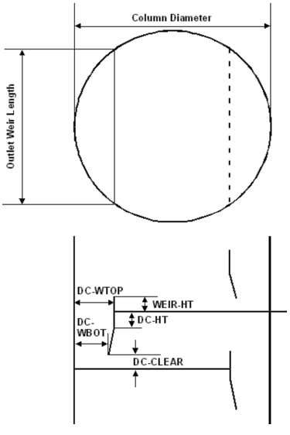
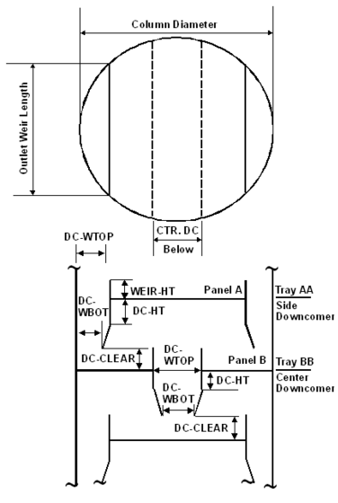
Trays Geometry

Slide 13
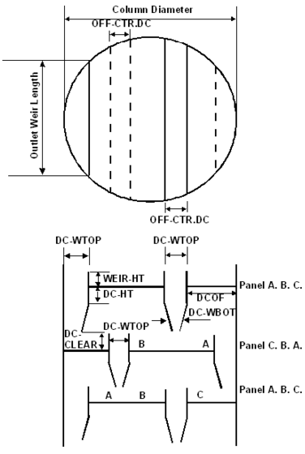
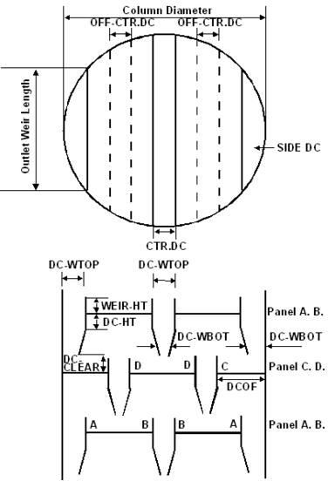
Trays Geometry

