Slide 1
Gas Compression Part I
Ref.1: Ikoku, Natural Gas Production Engineering, John Wiley & Sons, 1984, Chapter 5.
Ref.2: Menon, Gas Pipeline Hydraulic, Taylor & Francis, 2005, Chapter 4.
Ref.3: GPSA Electronic Data Book, Gas Processors Association, 1998, Chapter 13.

Slide 2
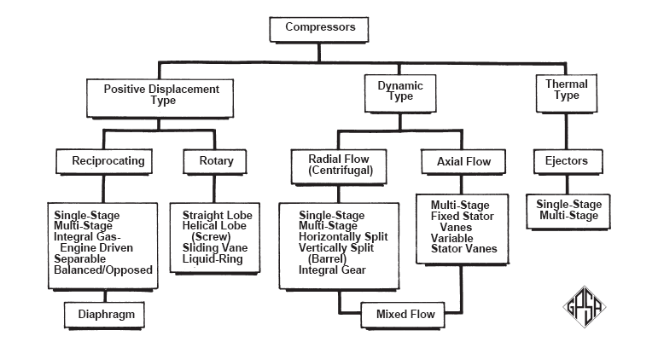
Gas Compression Type of Compressors
Depending on application, compressors are manufactured
as positive-displacement, dynamic, or thermal type:

Slide 3
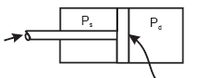
Gas Compression Reciprocating Compressors
The reciprocating compressor consists of one or more cylinders
each with a piston or plunger that moves back and forth,
displacing a positive volume with each stroke. They are single-acting or double-acting:
Clearance
Stroke length
A_{r} = Rod
diameter
A_{P} = Piston diameter
Single-acting
Double-acting

Slide 4
Gas Compression Reciprocating Compressors
Reciprocating compressors have pressure ranges up to 30,000 psi and range from very low HP to more than 20,000 HP per unit.
Reciprocating compressors can be single stage or multistage, depending upon the compression ratio required. The compression ratio per stage for positive displacement compressors is limited to 4.0 (because of the valve life and discharge temperature).
Gas cylinders are generally lubricated, although a non-lubricated design is available when warranted.
Typically, high-speed compressors operate at speeds of 900 to 1200 rpm and slow-speed units at speeds of 200 to 600 rpm.

Slide 5
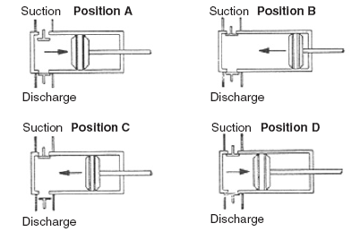
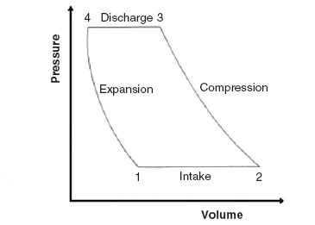
Gas Compression Reciprocating Compressors
On multistage machines, intercoolers may be provided between stages. These are heat exchangers which remove the heat of compression from the gas and reduce its temperature to approximately the intake compressor temperature.

Slide 6
Gas Compression Centrifugal Compressors
Centrifugal compressors develop the pressure required by the centrifugal force due to rotation of the compressor wheel that translates the kinetic energy into static pressure of the gas.
Centrifugal compressors can be used for outlet pressures as high as 10,000 psia, and inlet capacity of more than 100000 cfm.
Centrifugal compressors are usually either turbine or electric motor driven. Typical operating speeds for centrifugal compressors in gas transmission applications are about 14,000 rpm for 5000-hp units and 8000 rpm for 20,000-hp units.
In gas pipeline applications a compression ratio of 1.5 to 2.0 is usually used.

Slide 7
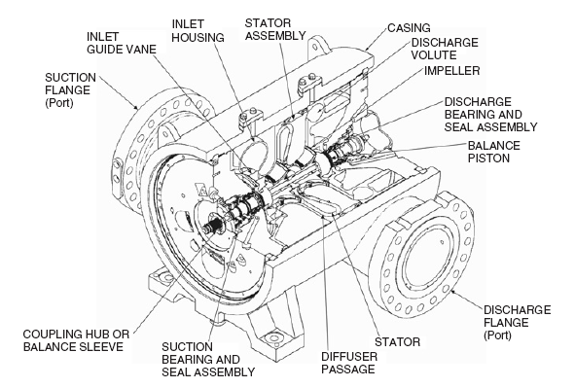
Gas Compression Centrifugal Compressors
A compressor body may hold one or several (up to 8 or 10) stages. A compressor train may consist of one or multiple compressor bodies. Pipeline compressors are typically single body trains, with one or two stages.

Slide 8
Gas Compression Advantages of a Reciprocating Compressor
Ideal for low volume flow and high-pressure ratios
High efficiency at high-pressure ratios (about 4)
Relatively low capital cost in small units (less than 3000 hp)
Less sensitive to changes in composition and density
Have flexibility in pressure range, and can deliver compressed gas at a wide range of pressures

Slide 9
Gas Compression Advantages of a Centrifugal Compressor
Ideal for high volume flow and low head
Simple construction with only one moving part
High efficiency over normal operating range
Low maintenance cost and high availability
Greater volume capacity per unit of plot area
No vibrations and pulsations generated

Slide 10
Gas Compression Compressor Selection and Rating
A Gas engineer in the field is frequently required to determine the desired specifications of a new compressor station or selecting the operating point of an existing one. These specifications are:
Type, number of stages, arrangements (parallel, series, inter and after coolers), driver, speed, efficiency, power and/or capacity of each stages or units, duty of coolers.
For determining the above specifications, these parameters are required: Gas Composition(or specific gravity), inlet temperature and pressure, total pressure ratio and total gas flow rate.

Slide 11
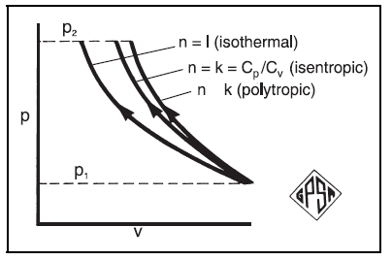
Gas Compression Compressor Head and Power
There are three ways in which the thermodynamic calculations for compression can be carried out — by assuming:
1. Isentropic process, PV ^{k} = constant, k = isentropic factor
2. Polytropic process, PV ^{n} = constant, n = polytropic factor
3. Isothermal process, PV = constant
>

Slide 12
Gas Compression Compressor Head (Isothermal)

Slide 13
Gas Compression Compressor Head (Isentropic and Polytropic)

Slide 14
Gas Compression Compressor Horsepower

Slide 15
Gas Compression Gas Horsepower

Slide 16
Gas Compression Isentropic and Polytropic Efficiency
Fig. 13-37

Slide 17
Gas Compression Discharge Temperature

Slide 18
