Slide 1
Gas Hydrates
In Gas Pipeline Transmission
Ref.1: Mokhatab et al, Handbook of Natural Gas Transmission and Processing, Gulf Publishing Com., 2006, Chapter 3.
Ref.2: Sloan, Clathrate hydrates of natural gases, Marcel Decker Inc., 1998.

Slide 2
Gas Hydrate
A gas hydrate is an ice-like crystalline solid called a clathrate, which occurs when water molecules form a cage-like structure around smaller guest molecules.
The most common guest molecules are methane, ethane, propane, i-butane, n-butane, nitrogen, carbon dioxide, and hydrogen sulfide.
Three different hydrate structures are known, namely as sI, sII and sH. The two most common structures in raw and sales gas transmission pipelines are sI and sII.

Slide 3
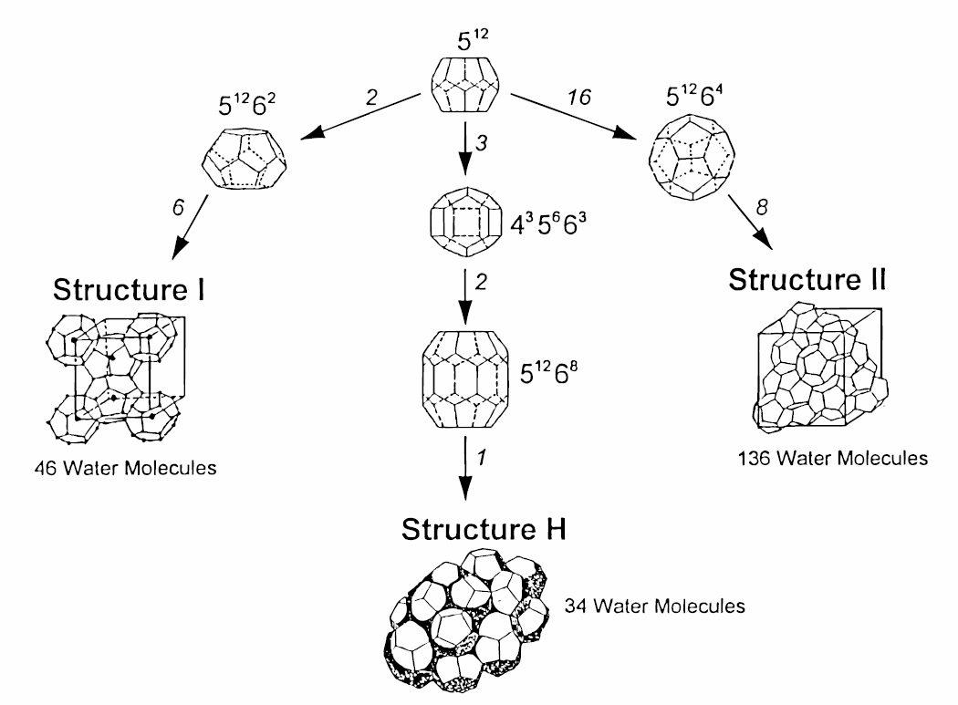
Gas Hydrate

Slide 4
Gas Hydrate
Type sI formed by smaller gas molecules such as methane, ethane, hydrogen sulfide, and carbon dioxide.
Type sII formed by larger gas molecules such as propane and i-butane. However, nitrogen, a relatively small molecule, also forms a type sII.
The hydrate structure formed by natural gas, may change from sII, at low temperatures and pressures, to sI, at high pressures and temperatures.

Slide 5
Gas Hydrate
It should be noted that n-butane does form a hydrate, but is very unstable. However, it will form a stabilized hydrate in the presence of small “help” gases such as methane or nitrogen.
It has been assumed that normal paraffin molecules larger than n-butane are nonhydrate formers.
Some isoparaffins and cycloalkanes larger than pentane are known to form sH hydrates.

Slide 6
Gas Hydrate
Note that free water is not necessary for hydrate formation, but it certainly enhances hydrate formation.
For any particular composition of gas at a given pressure, there is a temperature below which hydrates will form and above which hydrates will not form. As the pressure increases, the hydrate formation temperature also increases.
As a general rule, when the pressure of the gas stream increases or as the gas becomes colder, the tendency to form hydrates increases.

Slide 7
Gas Hydrate
Although gas hydrates may be of potential benefit both as an important source of hydrocarbon energy and as a means of storing and transmitting natural gas, they represent a severe operational problem, as the hydrate crystals may deposit on the pipe wall and accumulate as large plugs that can completely block pipelines, shutting in production.
In gas pipeline transmission to prevent hydrate formation, usually two common methods, namely thermal and chemical, are used.

Slide 8
Gas Hydrate
Prediction of Hydrate Formation Conditions
There are numerous methods available for predicting hydrate formation conditions. Two popular methods for rapid estimation of hydrate formation conditions and one basic method used in computer softwares are discussed here.
K-Factor Method: This method was developed originally by Carson and Katz (1942), although additional data and charts have been reproduced since then. In this method, the hydrate temperature can be predicted using equilibrium constants (K-Factor).

Slide 9
Gas Hydrate
K- Factor Method
The basic equation for this prediction is
where y_{i} is mole fraction of component i in gas on a water-free basis, K_{i} is vapor–solid equilibrium constant for component i, and n is number of components.
The calculation is iterative and the incipient solid formation point will determine when the aforementioned equation is satisfied. This method gives reasonable results for sweet natural gases and has been proven to be appropriate up to about 1000 psia.

Slide 10
Gas Hydrate
K- Factor Method
The vapor–solid equilibrium constant is determined experimentally and is defined as the ratio of the mole fraction of the hydrocarbon component in gas on a water-free basis to the mole fraction of the hydrocarbon component in the solid on a water-free basis (K_{i} = y_{i}/x_{i}, Figures 1 through 7).
For nitrogen and components heavier than butane, the equilibrium constant is taken as infinity. Theoretically, this assumption is not correct, but from a practical viewpoint provides acceptable engineering results.

Slide 11
Gas Hydrate
Gas Gravity Method
Gas Gravity Method: This method can be used when the gas composition is not known (Katz chart - 1945). The Katz’s method is an appropriate method of estimating hydrate formation conditions for sweet natural gas mixtures.
As a first step to predict hydrate formation temperature, one can develop an appropriate equation representing the Katz gravity chart (Towler and Mokhatab, 2005):

Slide 12
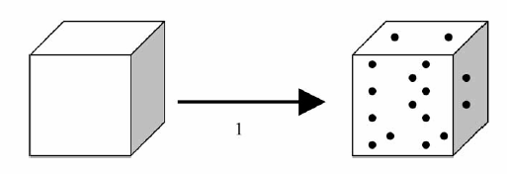
Gas Hydrate
Van der Waals and Platteeuw Method
In Van der Waals and Platteeuw (1959) method (modified by Parrish and Prausnitz-1972) two stage is assumed for hydrate formation. In the first stage, the empty hydrate lattice is generated by pure water. In the second stage, the cavities are filled by guest molecules.

Slide 13
Gas Hydrate
Van der Waals and Platteeuw Method
The chemical potential of water in filled hydrate structure (μ_{w}^{H}) is calculated by using statistical thermodynamics as follows:
Where
μ_{w}^{β} = the chemical potential of water in empty hydrate structure
n_{ci} = number of cavities of type i per water molecule in basic lattice
θ_{ji} = fractional occupancy of type i cavity by type j molecule

Slide 14
Gas Hydrate
Van der Waals and Platteeuw Method
The fractional occupancy of hydrate cavities can be calculated by using Langmuir adsorption theory:
Where
C_{ji} = the Langmuir constant of type j molecule in type i cavity
f_{j} = the fugacity of type j molecule in the gas phase and can be calculated by using an equation of state such as PR

Slide 15
Gas Hydrate
Van der Waals and Platteeuw Method
The Langmuir constant is the key parameter of van der Waals - Platteeuw model, which depends on the interaction potential between guest molecule and water molecules and can be calculated as follows:
Where
R = the average redius of type i cavity
w = the potential interaction function between the guest molecule and cavity, commonly represented by Lennard – Jones or Kihara potential function.

Slide 16
Gas Hydrate
Van der Waals and Platteeuw Method
The chemical potential of water in empty hydrate structure (μ_{w}^{β}) and in liquid phase (μ_{w}^{L}) are calculated by using classical thermodynamics as follows :
Where h_{w} , v_{w} and a_{w} are enthalpy, volume and activity of water and superscripts β, L and L_{pure} are empty hydrate, liquid and pure liquid, respectively.

Slide 17
Gas Hydrate
Van der Waals and Platteeuw Method
At equilibrium, the chemical potential of water in the filled hydrate structure (μ_{w}^{H}) must be equal to the chemical potential of water in the liquid phase (μ_{w}^{L}). Therefore, the equilibruim temperature or pressure of hydrate formation can be calculated by try and error from equations 1-5, based on the above rule.
In AspenHysys or Aspen plus a modified version of van der Waals – Platteeuw method was used for calculating the hydrate formation conditions.

Slide 18
Gas Hydrate
Example
For a mixture of natural gas with the following composition calculate the equilibrium conditions (pressure and temperature) of hydrate formation using the HYSYS software. Use the experimental data of this paper for comparison:
Jager and Sloan, 4th International Conference of Gas Hydrate, Yokahama, Japan (2002).
Mole percent of natural gas
methane | ethane | propane | i-butane
97.5275 | 0.8797 | 0.1397 | 0.0149
n-butane | i-pentane | n-pentane | n-hexane
0.0248 | 0.0180 | 0.0203 | 0.0222
n-heptane | nitrogen | carbon dioxide
0.0126 | 0.9303 | 0.4100

Slide 20
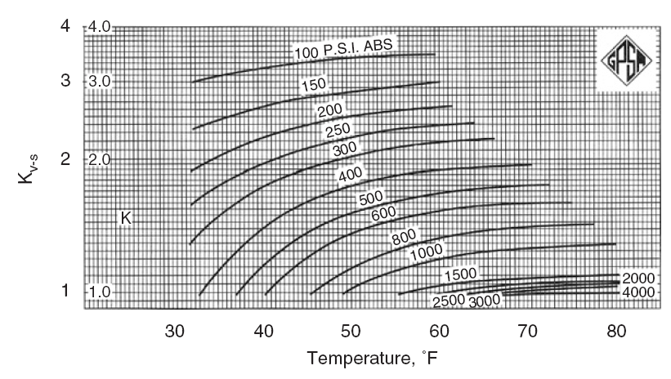
Figure 1. Vapor–solid equilibrium constants for methane (GPSA, 1998).

Slide 21
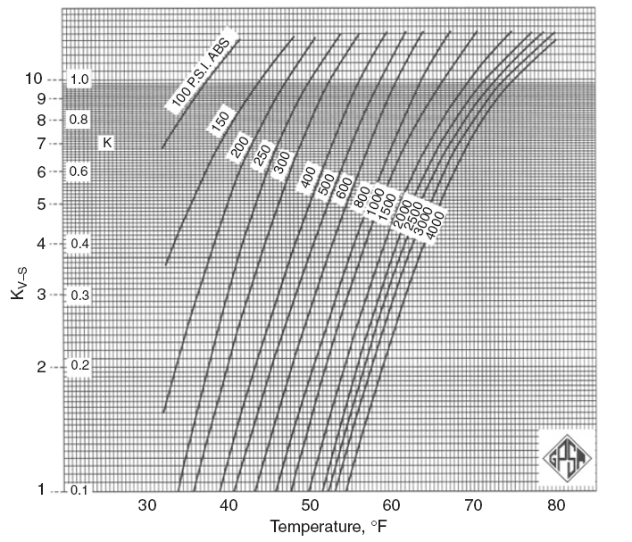
Figure 2. Vapor–solid equilibrium constants for ethane (GPSA, 1998).

Slide 22
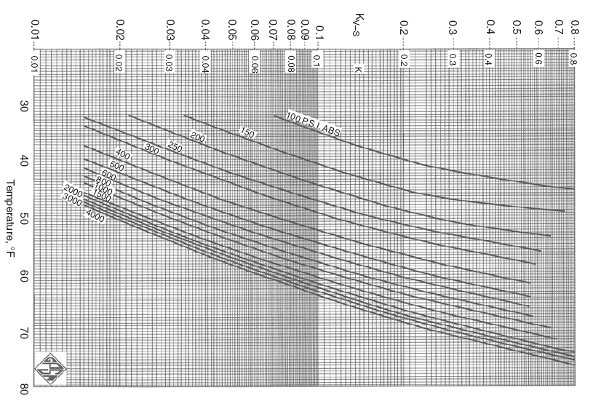
Figure 3. Vapor–solid equilibrium constants for propane (GPSA, 1998).

Slide 23
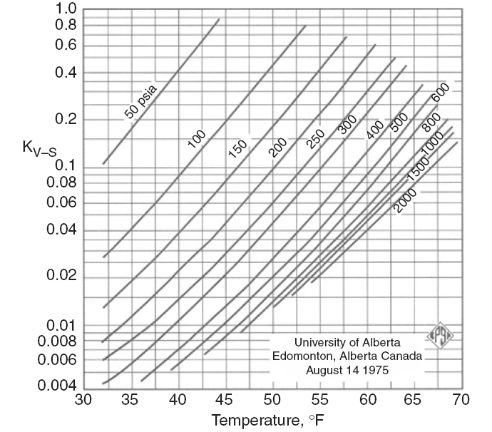
Figure 4. Vapor–solid equilibrium constants for i-butane (GPSA, 1998).

Slide 24
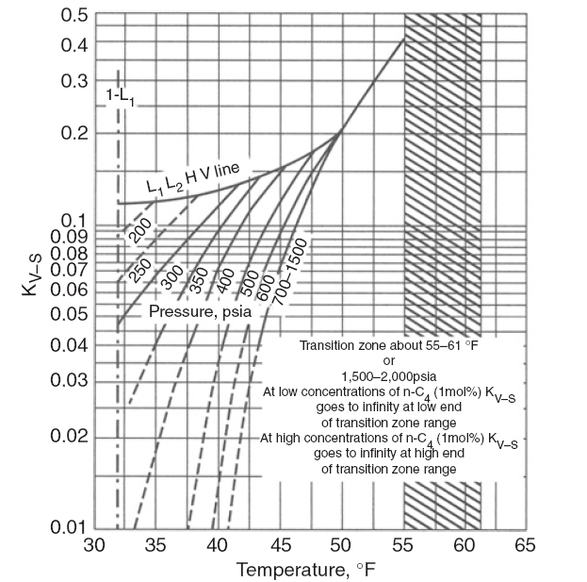
Figure 5. Vapor–solid equilibrium constants for n-butane (GPSA, 1998).

Slide 25
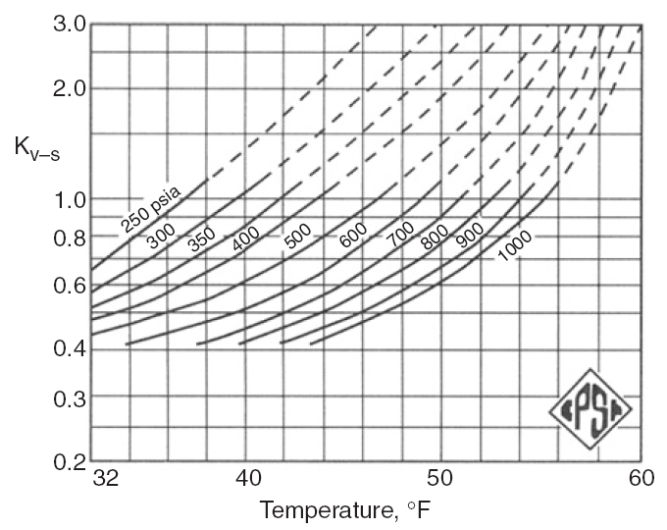
Figure 6. Vapor–solid equilibrium constants for CO₂ (GPSA, 1998).

Slide 26
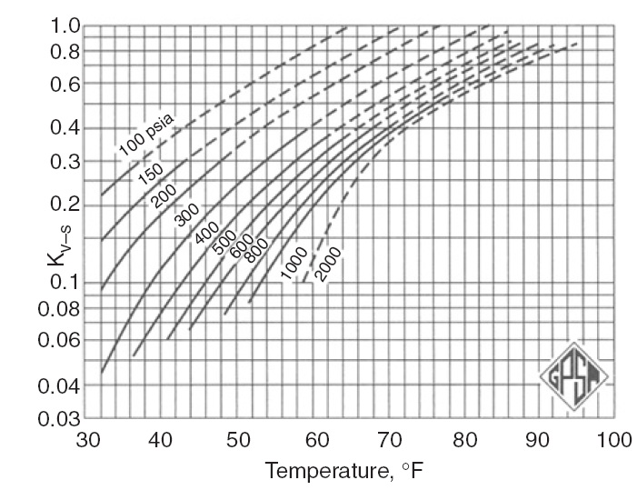
Figure 7. Vapor–solid equilibrium constants for H₂S (GPSA, 1998).

Slide 27
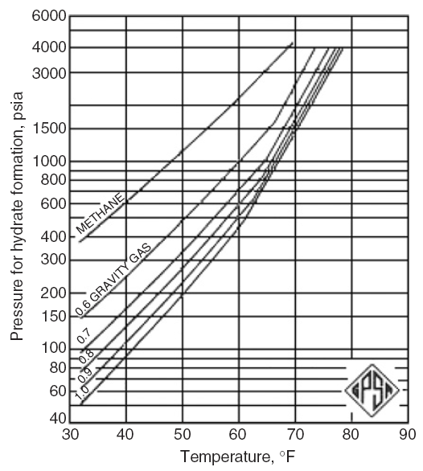
Figure 8. Katz’s gravity chart for predicting hydrate formation conditions (GPSA, 1998).

