Slide 1
Introduction to Crude Oil Distillation
Ref.1: R. Smith, Chemical Process Design and Integration, Wiley, 2005, Chapter 11.
Ref.2: Y.A. Liu et al, Petroleum Refinery Process Modeling, Wiley-VCH, 2018 , Chapter 2.

Slide 2
Crude Oil Distillation Process Overview
Figure 1 shows the general process flow in the distillation unit of a refinery. The solid lines refer to primary material flows and the dashed lines refer to energy flows.
Crude enters an initial heat recovery section to raise its temperature and recover heat from downstream units. The heated crude then enters a desalting section, which removes dissolved salts and associated impurities.
Fig. 1

Slide 3
Crude Oil Distillation Process Overview
Once the salts have been sufficiently treated, the crude enters the preheat train, consisting of heat exchangers associated with various downstream equipment throughout the refinery. The preheat train typically raises the temperature of crude significantly and reduces the overall energy consumption in the refinery. Following the preheat train, the crude enters the primary crude furnace.
Fig. 1

Slide 4
Crude Oil Distillation Process Overview
The crude furnace vaporizes a major portion of the crude and feeds this vapor–liquid mixture into the atmospheric distillation tower. Most refineries today recover the products and send them for further processing into vacuum distillation section and product upgrading sections (catalytic cracking, hydrocracking, reforming, etc.).
Fig. 1

Slide 5
Crude Oil Distillation Desalting
Before the crude enters the actual crude distillation column, it must go through several steps to ensure reliable operation. The main steps are as follows:
• Desalting
• Dewatering
• Solid removal
Most crude contains appreciable levels of salts (20–500 ppm). It is critical to remove these salts to prevent fouling and scaling of heat transfer surfaces. Figure 2 shows a typical crude desalting process. The charge crude from the storage is preheated to a particular salt removal temperature (around 80–150 ∘C).

Slide 6
Crude Oil Distillation Desalting
Fig. 2
Large quantities of water come in contact with the crude. The salts will dissolve preferentially in the water until its saturation point. Next, the water coalesces to large water droplets in the presence of a strong electric field. The droplets begin to settle out from the oil due to gravity.

Slide 7
Crude Oil Distillation Desalting
Fig. 2
Refiners processing a variety of crudes may include several desalting stages to ensure that the process effectively reduces salts to a minimal level. Due to the presence of other impurities in the crude, refiners may also add de-emulsification agents to prevent forming of oil–water emulsions.

Slide 8
Crude Oil Distillation Desalting
Fig. 2
For the purpose of modeling the CDU, we consider the desalting operation as a simple component splitter that removes any water present in the feed crude. Desalting and dewatering processes are very effective and do not consume significant resources compared to other units, so this simple model representation is justified.

Slide 9
Crude Oil Distillation Preheat Train and Heat Recovery
The CDU consumes 20–30% of the total energy required to produce petroleum products from a given crude. Therefore, it is critical to optimize and recover as much heat as possible from hot streams.
The preheat train consists of heat exchangers that incrementally heat up the crude feed using hot streams from the crude distillation and other downstream units in the refinery. Crude exits in the preheat train at around 280 ∘C.
Design and optimization of preheat train can be done based on the pinch technology. Aspen Energy Analyzer of AspenTech can be used for this purpose.

Slide 10
Crude Oil Distillation Pre-fractionation
In the preheating train, the crude is under pressure to suppress vaporization. In the case of a light crude, the pressure required to suppress vaporization is too high. Therefore the light components must be separated before heating the crude further in the preheat train.
With respect to the amount of light components in the crude, a single flash or a pre-fractionation column maybe used. In the pre-fractionation design, the light components are separated from top of column (condenser) into two fractions: light ends as gas and light naphtha as liquid.

Slide 11
Crude Oil Distillation Atmospheric
After leaving the preheat train, the heated crude with temperature about 280 ºC enters the atmospheric crude distillation furnace. The vapor–liquid crude mixture leaves the furnace and enters to the atmospheric crude distillation column (topping process) with temperature around 380–410 ∘C .
Designs of topping process are normally thermally coupled. Most configurations follow the thermally coupled indirect sequence as shown in Figure 3 (a). However, rather than build the configuration in Figure 3 (a), the configuration of Figure 3 (b) is the one normally constructed. Notice that the two arrangements are equivalent.

Slide 12
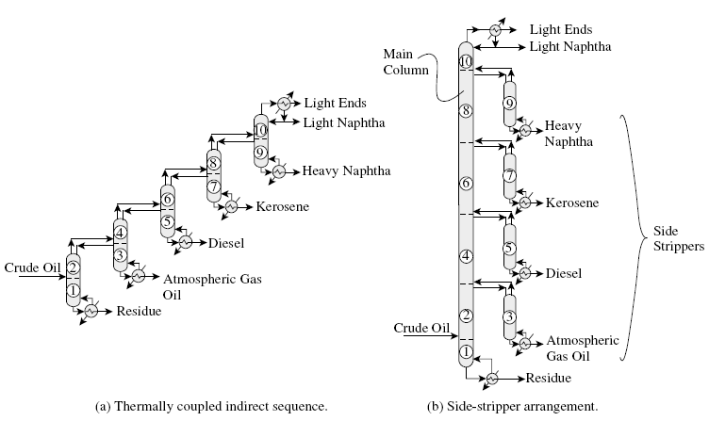
Crude Oil Distillation Atmospheric
Fig. 3

Slide 13
Unfortunately, a practical crude oil distillation cannot be operated in quite the way shown in Figure 3 (b), because:
If high-temperature reboiling is used, as would be required for the higher boiling products in the lower part of the column in Figure 3 (b), extremely high temperature sources of heat would be required. Steam is usually not distributed for process heating at such high temperatures.
High temperatures in the reboilers would result in significant fouling of the reboilers from decomposition of the hydrocarbons to form coke.

Slide 14
Therefore, in practice, some or all of the reboiling is substituted by the direct injection of steam into the distillation. The steam has two functions:
It provides some of the heat required for the distillation. The reminder required heat is prepared by a furnace.
It lowers the partial pressure of the boiling components, making them more volatile.
The steam is condensed in the overhead and is separated in a decanter from the hydrocarbons.

Slide 15
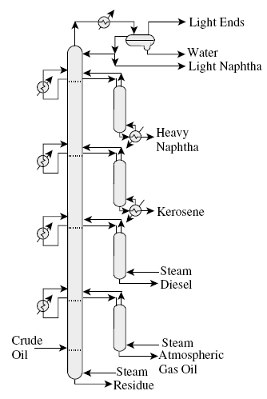
Another problem with the arrangement in Figure 3 (b) is that as the vapor rises up the main column, its flow rate increases significantly.
This problem can be solved by removing heat from the main column at intermediate points by pumparound. This corresponds with introducing some condensation of the vapor at the top of intermediate columns.

Slide 16
Crude Oil Distillation Pumparound
In a pumparound, liquid is taken from the column, sub cooled and returned to the column at a higher point.
By choosing the most appropriate flow rate and temperature for the pumparound, the heat load to be removed can be adjusted to whatever is desired.
The trays between the liquid draw and return in a pumparound have more to do with heat transfer than mass transfer. In addition to returning a sub cooled liquid to the column, mixing occurs as material is introduced to a higher point in the column. Therefore by using pumparound, the effective number of trays will be reduced.

Slide 17
Crude Oil Distillation Furnace
The crude oil entering the topping column needs to be preheated to around 400 ºC. This is down by a furnace (fired heater). Note that this temperature is higher than decomposition limit, but a high temperature can be tolerated in the furnace if it is only for a short residence time.
All of the material that needs to leave as product above the feed point (flash zone) must vaporize as it enters the column. In addition to this, some extra vapor over and above this flowrate must be created that will be condensed and flow back down through the column as reflux. This extra vaporization to create reflux is known as overflash (typically in the rage of 1-10%).

Slide 18
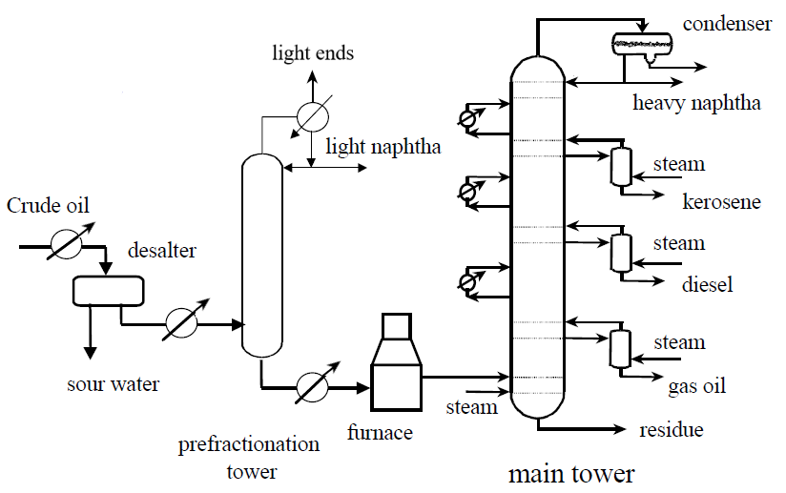
Crude Oil Distillation Furnace
Most topping column also include a significant amount of steam at the bottom. This steam serves to strip residue and prevent excessive thermal cracking of crude due to high temperatures.
Fig. 4

Slide 19
Crude Oil Distillation Vacuum
The residue leaving the atmospheric tower still contains significant amount of valuable oils. These oils cannot be distillated at atmospheric pressure because the temperature required would be so high that severe thermal cracking takes place.
The atmospheric residue is usually reheated to a temperature around 400 ºC (750 ºF) or slightly higher and fed to a vacuum column, which operates under a high vacuum (about 20-50 mmHg at feed flash zone). As shown in the Figure 5.

Slide 20
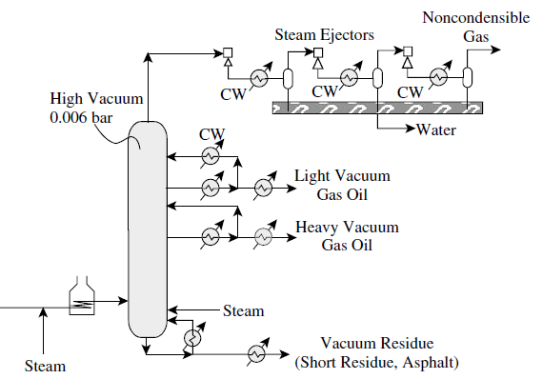
Crude Oil Distillation Vacuum
Fig. 5

Slide 21
Crude Oil Distillation Vacuum
Vacuum column does not have a condenser and does not feature side strippers either, simply because products (LVGO & HVGO), which are usually used as feedstocks for catalytic cracking units, do not have specifications on their light end. However, side strippers can be used in specific cases, when vacuum column is used for lube base oil production.
Lighter components are removed from the residue by steam stripping. In addition, coke formation is reduced by circulating partially cooled bottoms to quench the liquid to a lower temperature.

Slide 22
Crude Oil Distillation Fraction specifications
In the petroleum refinery, two terms are used for presenting the composition and degree of separation between adjacent petroleum fractions.
ASTM D86 boiling range (usually 95%) defines the general composition of the fraction and is usually one of the key specifications for distillation.
The second key specification, (5-95) gap, defines the relative degree of separation between adjacent fractions. It is determined by subtracting the D86 95% of light fraction from the D86 5% of heavy adjacent fraction.

