Slide 1
Design Guidelines of Crude Oil Distillation Units
Ref.1: M. Bagajewicz, Petroleum Fractionation-Overview, Lectures, 2007.
Ref.2: Y.A. Liu et al, Petroleum Refinery Process Modeling, Wiley-VCH, 2018 , Chapter 2.
Ref.3: HAT International, “Alpha Tray Design Sheet”, www.hatltd.com

Slide 2
Crude Oil Distillation
Model development
In general, the two major approaches for modeling columns are the rate-based and equilibrium-stage approach.
In the rate-based approach, multistage operations are defined on the basis of rigorous heat and mass transfer rates between the vapor and liquid phases, and thermodynamic equilibrium between the vapor and liquid phases occurs at the vapor–liquid interface. This approach can be highly accurate and account for numerous phenomena including the physical layout of the column. However, this approach is also very demanding in terms of the parameter values required to produce a reasonable model.

Slide 3
Crude Oil Distillation
Model development
The more traditional approach for modeling multistage operations is the equilibrium-stage approach. In this approach, we consider each stage to separate the vapor–liquid mixture based on thermodynamics and on heat and mass balance constraints alone.

Slide 4
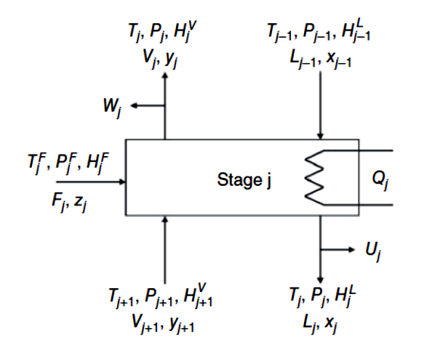
Crude Oil Distillation
Model development
We collectively refer to model Eqs. as Material, Equilibrium, Summation, and Heat equations or MESH equations.

Slide 5
Crude Oil Distillation
Model development
To simulate an actual column, we first convert the actual number of stages to an equivalent number of equilibrium stages by using an overall stage efficiency. Overall stage efficiency refers to the ratio of ideal (or theoretical) stages contained in the column (excluding the condenser and the reboiler) to the actual physical trays.
For hydrocarbon distillation, the overall stage efficiencies are 50–90%. For absorption processes, the range is 10–50%.
In general, the overall efficiency for crude oil distillation is roughly 0.5 and the column model contains around 25 to 35 theoretical stages (excluding the side strippers).

Slide 6
Crude Oil Distillation
Model development
A popular method in dealing with the nonideal stage behavior in process simulators is to use an individual stage efficiency, called Murphree vapor stage efficiency.
Users of process simulators often enter the actual number of stages or trays from the column process flow diagram (PFD) to the simulator and enter individual stage efficiency values independent of components, for different stages in the column such that the actual column operation is replicated.
Unfortunately, many engineers do not understand the serious limitations of the individual stage efficiency models.

Slide 7
Crude Oil Distillation
Model development
There are no reports of typical individual stage efficiency values for petroleum columns. The user must then manipulate individual stage efficiency values in the column in order for the simulation results to match the plant data. This manipulation of individual stage efficiencies is similar to the regression fitting of data to an equation form.
The worst consequence of using these individual stage efficiencies is that the simulation model would likely become useless for predicting the performance of the column at operating conditions different from those used to develop the column model, because the principle of equilibrium vapor and liquid leaving each stage has been violated.

Slide 8
Crude Oil Distillation
Model development
When modeling existing columns, we recommend to use a typical overall stage efficiency value to convert the actual number of trays (stages) to the equivalent number of theoretical stages. In this case the model predictions for a new set of operating conditions are correct.
Separation section | Theoretical stages | Overall efficiency
Column top to naphtha | 6 to 8 | 0.6
Naphtha to kerosene | 4 to 6 | 0.5
Kerosene to diesel | 3 to 4 | 0.5
Diesel to gas oil | 4 to 6 | 0.4
gas oil to flash zone | 3 to 4 | 0.3
Flash zone to bottom | 1 to 2 | 0.2
Open-steam side stripper | 2 to 3 | 0.3
Reboiled side stripper | 3 to 4 | 0.5

Slide 9
Crude Oil Distillation
Design guidelines
The first step in designing the atmospheric distillation column is the column pressure. The minimum pressure is the lowest permissible pressure in the reflux drum. The practical range is 0.2 to 1.0 psig. The design pressure drop across the condenser should be set to 5 psi.
The allowable pressure drop for trays will be about 0.1 to 0.2 psi per tray. Most atmospheric towers have 20 to 28 theoretical stages between the flash zone and the tower top. So a pressure drop of 3 to 6 psi can be assumed between the flash zone and the tower top. A pressure drop of 5.0 psi between the flash zone and the furnace outlet is recommended.

Slide 10
Crude Oil Distillation
Design guidelines
Volumetric flow of petroleum fractions can be estimated from TBP curve of crude oil based on TBP cut points as shown in the following Table:
Petroleum fraction | TBP cut points (ºF)
Light ends | IBP-100
Light straight run (LSR) | 100-220
Naphtha | 220-380
Kerosene | 380-480
Diesel | 480-610
Atmospheric gas oil (AGO) | 610-690
Light vacuum gas oil (LVGO) | 690-800
Heavy vacuum gas oil (HVGO) | 800-1000
Vacuum residue | 1000-FBP

Slide 11
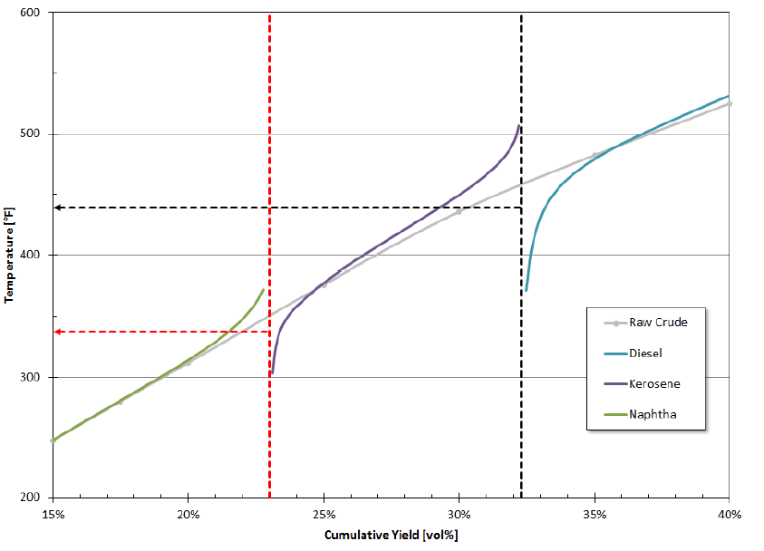
Crude Oil Distillation
Design guidelines
The relationship between TBP cut points of petroleum fractions and whole TBP curve of petroleum fractions are shown in the following Figure.

Slide 12
Crude Oil Distillation
Design guidelines
TBP overlap is defined as
(TBP EP of light fraction)-(TBP IP of heavy fraction)

Slide 13
Crude Oil Distillation
Design guidelines
The recommended specifications for petroleum fractions, ASTM D86 at 95% point, and (5-95) gap are shown in the following Tables:
Petroleum fraction | ASTM D86, 95% (ºF)
LSR | 210-250
Naphtha | 360
Kerosene | 520
Diesel | 620
Atmospheric gas oil (AGO) | 710-770
Petroleum fraction | (5-95) gap (ºF)
Naphtha - LSR | ≥ 30
Kerosene - Naphtha | ≥ 30
Diesel - Kerosene | ≥ 0
AGO - Diesel | -10 to -20

Slide 14
Crude Oil Distillation
Design guidelines
The required flowrate of steam in side strippers and main column can be estimated based on the following guideline:
lb of steam/bbl of product = 8 to 10
The original purpose of adding pump-around circuits was to reduce vapor and liquid traffic at the top section of the column. Without pump-around circuits, all condensation heat has to be removed from the condenser, which results in a large vapor flowrate at the top trays.

Slide 15
Crude Oil Distillation
Design guidelines
The presence of the pump-around circuit decreases the number of effective ideal trays. The effect can be even more detrimental to separation if the flowrate of a pump-around circuit is increased.
These effects can be compensated to a certain extent by increasing the steam rate in the side strippers. Another solution is to increase the number of trays. However, with the constant total number of trays, the relationship between heat recovery and steam consumption can be incorporated into the design procedure.

Slide 16
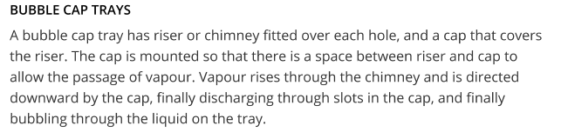
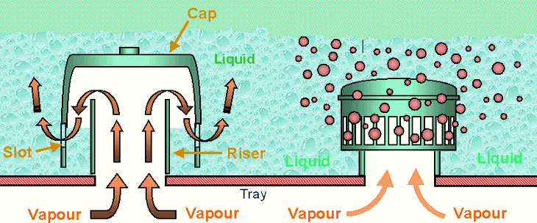
Column Internals
Trays Types
There are three types of cross-flow trays: (1) sieve, (2) valve and (3) bubble cap.

Slide 17
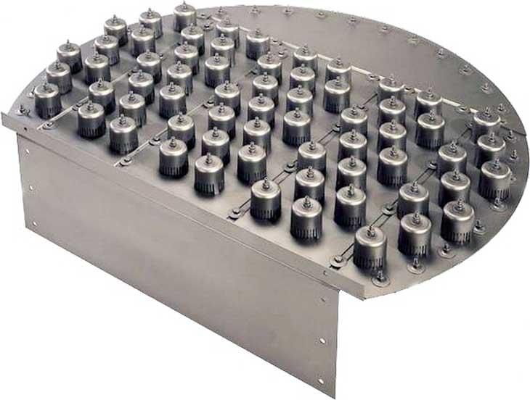
Column Internals
Trays Types

Slide 18
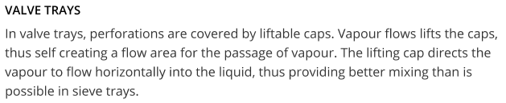
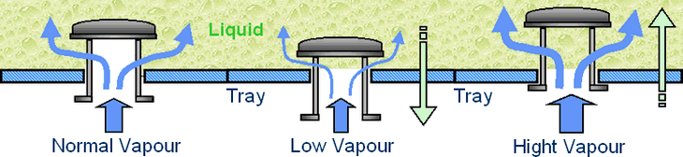
Column Internals
Trays Types

Slide 19
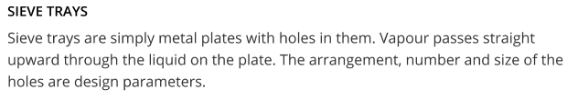
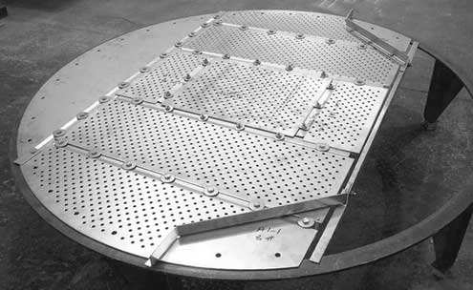
Column Internals
Trays Types

Slide 20
Comparing Trays Performance
The principle factors in comparing the performance of trays are:
Cost: Bubble-caps are appreciably more expensive than sieve or valve trays. Due to its simple design, sieve trays are normally the cheapest. (Rel. Cost: 1.0 sieve, 1.2 valve, 2.0 bubble-cap)
Turndown Ratio: The ratio of the highest to the lowest flowrates of vapor over which the tray will operate satisfactorily. Bubble-cap trays have the highest turndown ratio, followed by valve tray (up to 10), and sieve tray (up to 2).

Slide 21
Comparing Trays Performance
Pressure Drop: The tray pressure drop will depend on the detailed design of the tray, but in general, sieve trays give the lowest pressure drop, followed by valves, and bubble-caps.
Maintenance: For dirty services, bubble-caps are not suitable as they are most susceptible to plugging. Sieve trays are the easiest to clean.

Slide 22
Trays Operation Limits
Jet Flood is the criteria used to predict the point at which massive liquid carryover will occur due to the height of spray on the tray deck exceeding the available tray space.
It is normal practice to limit tray design to a maximum of 80% of jet flood to allow a safety margin on tower control, possible discrepancies of VLE data and also the limitations of the flooding correlation used.

Slide 23
Trays Operation Limits
Entrainment Limit is reached when the velocity of vapor through the tray open area is high enough to project liquid droplets to the tray above.
Weeping occurs when the velocity of the vapor through the tray open area is too low to prevent liquid from leaking through the open area thus by-passing contact area to the tray below. Most valve and sieve trays will weep in normal operation (less than 10%).

Slide 24
Trays Operation Limits
Blowing Flood occurs at low liquid rates at which the tray operates in the spray regime resulting in massive entrainment of liquid to the tray above to the extent that the tray deck is essentially blown dry.
Downcomer Choke Flood occurs at high liquid loads when the downcomers are too small to allow effective vapor disengagement causing vapor entrainment to the tray below.

Slide 25
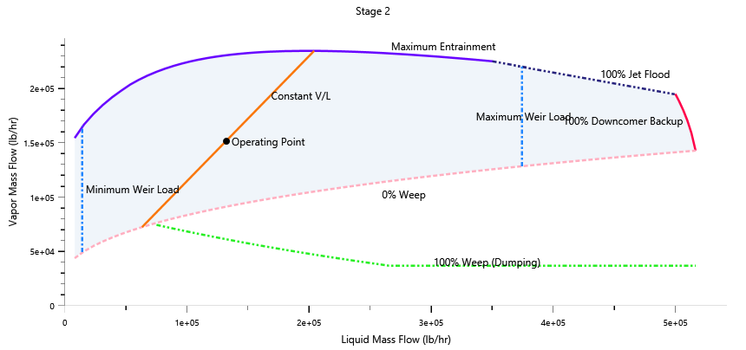
Trays Operation Limits
Downcomer Back-up occurs when the head of liquid (aerated) in the downcomer backs up onto the tray deck.
Other operation limits that may be used are: Minimum weir loading, Maximum weir loading and Maximum pressure drop.

Slide 26
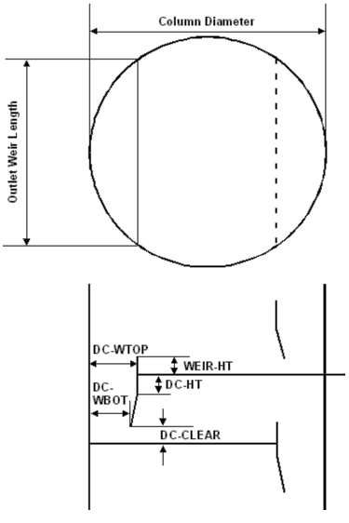
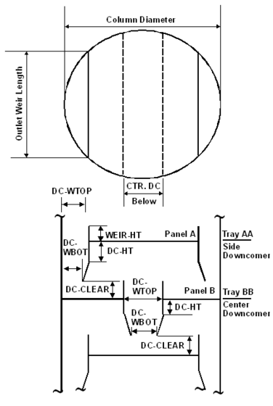
Trays Geometry

Slide 27
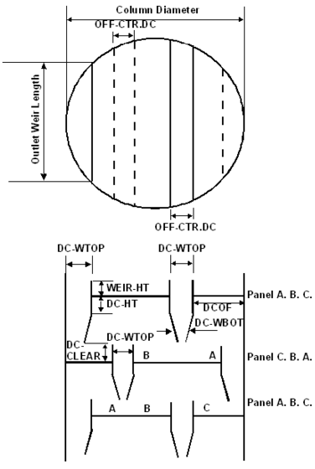
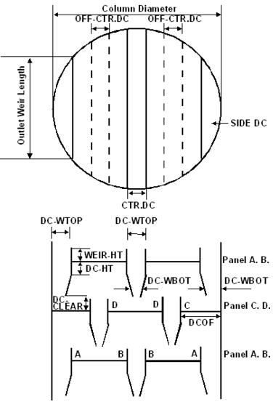
Trays Geometry

