Slide 1
Ratio and Constraint Control
Ref.: Smith & Corripio, Principles and practice of automatic process control, 3rd Edition, Wiley, 2006, Chapter 10.

Slide 2
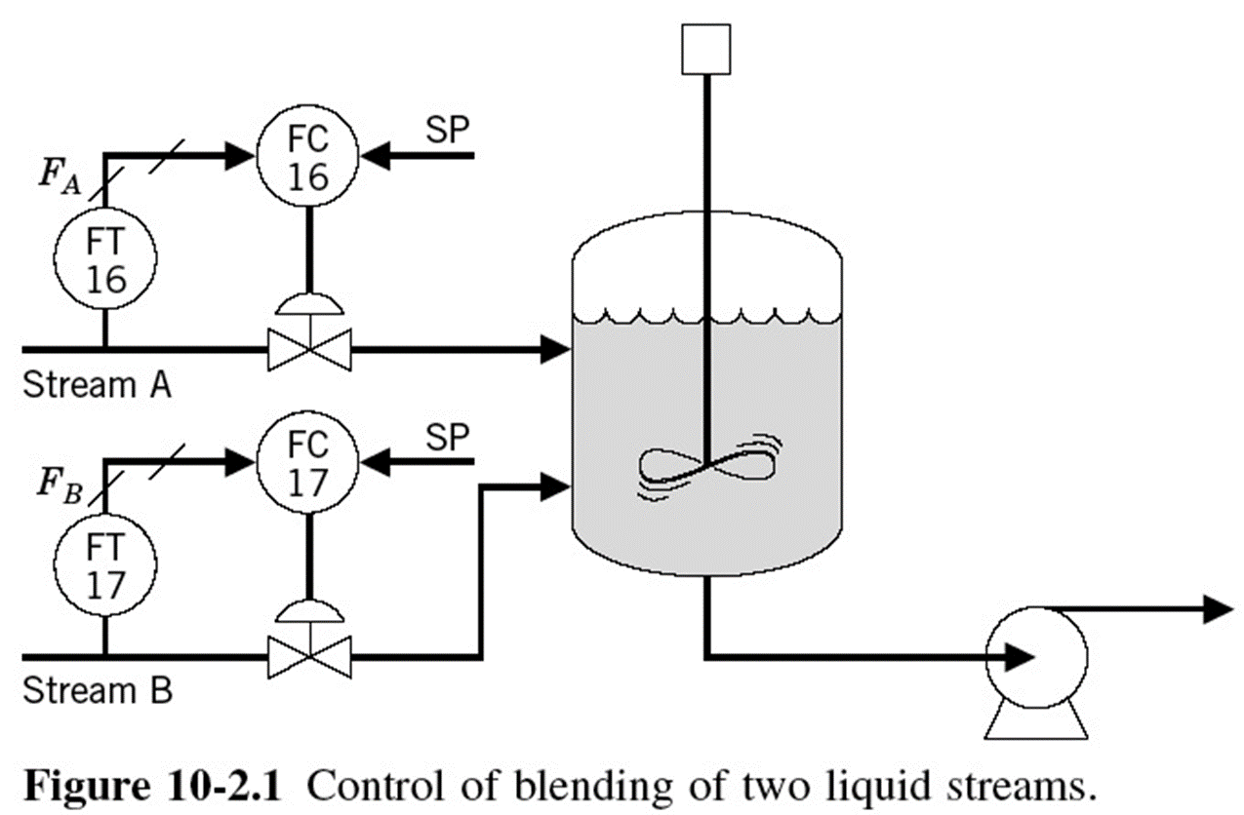
Example 1: Blending Process
Assume that it is required to blend two liquid streams, A and B, in some proportion, or ratio, R; R = F_{B} / F_{A}
Fig. 1

Slide 3
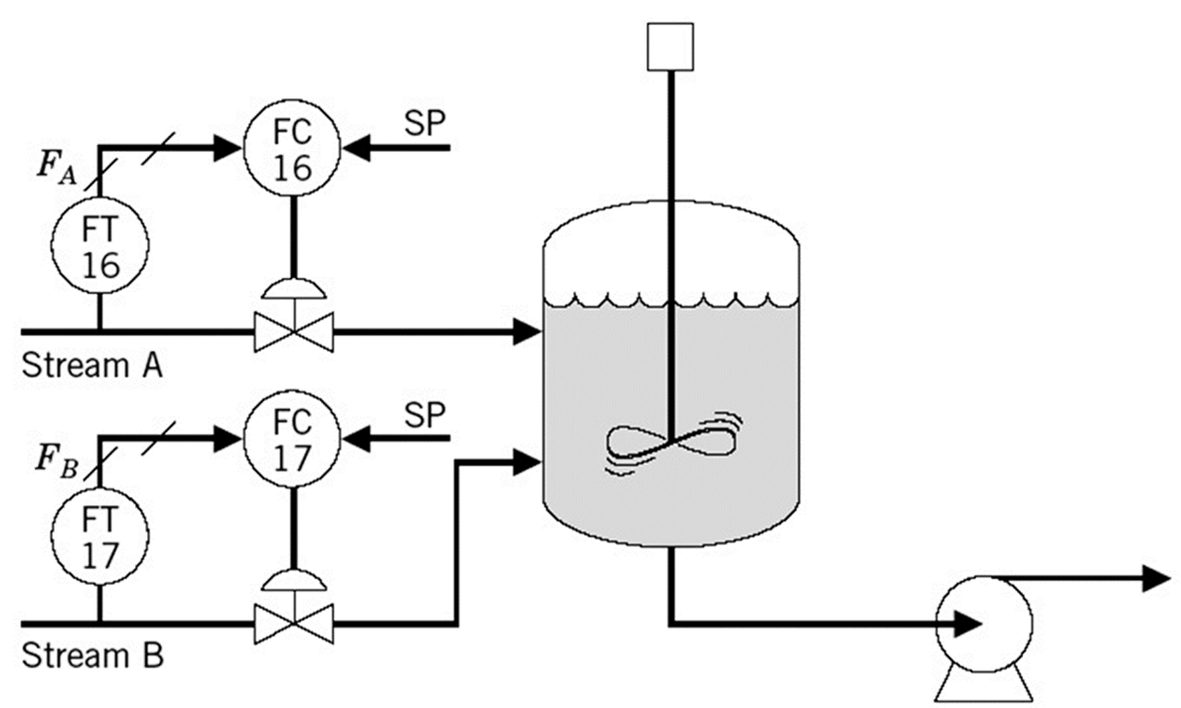
Example 1: Blending Process
An easy way of accomplishing this task is shown in the figure. Each stream is controlled by a flow loop in which the set points to the controllers are set such that the liquids are blended in the correct ratio.
Fig. 1

Slide 4
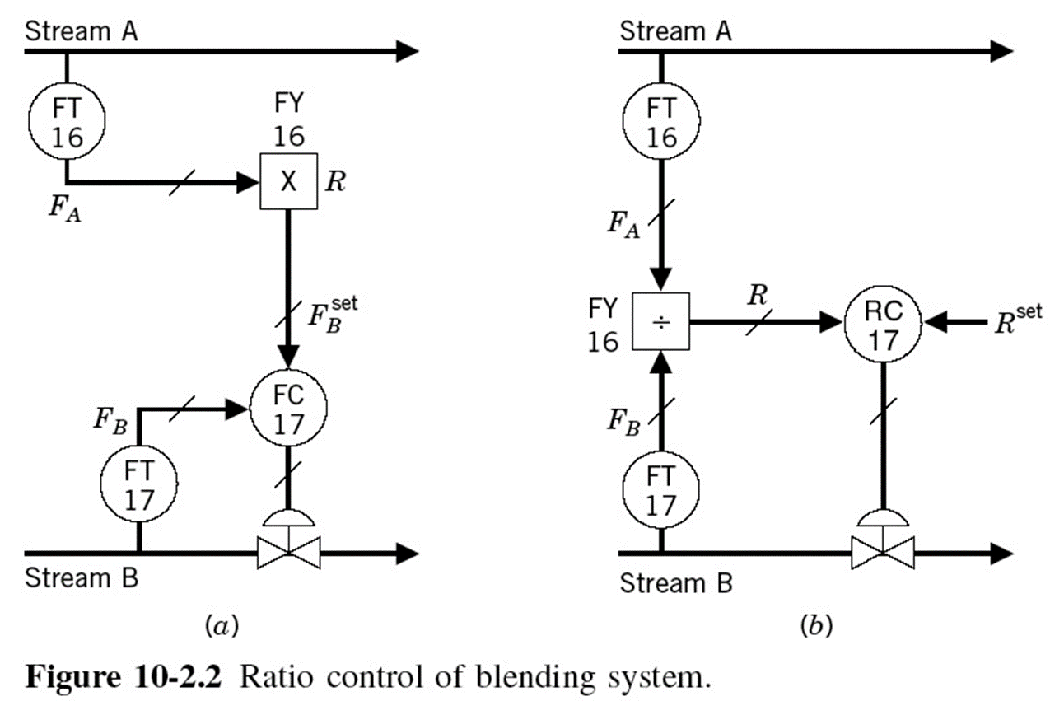
Example 1: Blending Process
Now, suppose that the flow rate of stream A, is manipulated to control something else, such as level or temperature, upstream.
The flow rate of stream B must vary, as the flow rate of stream A varies, to maintain the correct ratio. Two schemes are possible:
Fig. 2

Slide 5
Example 1: Blending Process
Both control schemes are used, but the scheme shown in Fig. (a) is preferred because it results in a more linear system than the one shown in Fig. (b).
This is demonstrated by analyzing the mathematical manipulations in both schemes.
Fig. 2

Slide 6
Example 1: Blending Process
In the first scheme, FY 16 solves the equation F_{B} = R F_{A}, The gain of this element is:
Which, as long as the required ratio is constant, is a constant value (linear).

Slide 7
Example 1: Blending Process
In the second scheme, FY 16 solves the equation, R = F_{B} / F_{A}, The gain of this element is:
So as the flow rate of stream A changes, this gain also changes, yielding a nonlinearity

Slide 8
Example 1: Blending Process
From a practical point of view, even if both streams can be controlled, the implementation of ratio control may still be more convenient than the control system shown in Fig. 1. Fig. 3 shows a ratio control scheme for this case.
Fig. 3

Slide 9
Example 2: Air/Fuel Ratio
Air is introduced in a excess of that stoichiometrically required for combustion of the fuel; this is done to ensure complete combustion.
Incomplete combustion not only results in the inefficient use of the fuel but may also result in smoke and the production of other pollutants.
The amount of excess air introduced depends on the type of fuel, the fuel composition, and the equipment used.
However, the greater the amount of excess air introduced, the greater the energy losses through the stack gases. Therefore, the control of the air and fuel flows is most important for proper safe and economical operation.

Slide 10
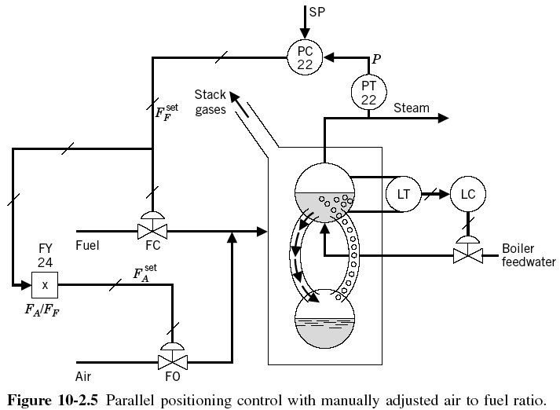
Example 2: Air/Fuel Ratio
The flow of fuel is generally used as the manipulated variable to maintain the pressure of the steam produced in the boiler at some desired value. Figure 4 shows one way to control the steam pressure as well as the fuel/air ratio control scheme. This scheme is called parallel positioning control.
Fig. 4

Slide 11
Example 2: Air/Fuel Ratio
This control scheme does not actually maintain a ratio of fuel to air; rather, it maintains a ratio of the signals to valves. The flow through these valves depends on these signals and on the pressure drop across them. Consequently, any pressure fluctuation changes the flow, and thus affects the combustion process and steam pressure.
Fig. 4

Slide 12
Example 2: Air/Fuel Ratio
A better control scheme to avoid these types of disturbances is full metering control. It is shown in Fig. 5. In this scheme the pressure controller sets the flow of fuel, and the air flow is ratioed to the fuel flow. The flow loops correct for any flow disturbances.
Fig. 5

Slide 13
Example 2: Air/Fuel Ratio
When the steam header pressure increases, probably because of a decrease in steam demand, the pressure controller reduces the demand for fuel.
As the set point to the fuel controller is reduced, the controller closes the valve to satisfy the set point. As the fuel flow decreases, the set point to the air flow controller is also reduced. Thus the air flow follows the fuel flow, and during a transient period, the combustible mixture is rich of air.
Fig. 5

Slide 14
Example 2: Air/Fuel Ratio
Now consider the case wherein the header pressure decreases, probably because of an increase in steam demand, and the pressure controller increases the demand for fuel.
As the set point to the fuel flow controller increases, the controller opens the valve to satisfy the set point. As the fuel flow increases, the set point to the air flow is increased; the air flow again follows the fuel flow. In this last case, the combustible mixture, during a transient period, is lean in air.
Fig. 5

Slide 15
Example 2: Air/Fuel Ratio
This situation is certainly not desirable for some important reasons. A lean air mixture results in unburned fuel in the stack gases, which is not a very safe (in fact, an explosive!), constitutes an environmental hazard and a waste of energy and money.
Therefore, a control scheme must be designed to avoid these situations. The control scheme must be such that when more combustibles are required to maintain pressure, it increases the air first and then the fuel. When less combustibles are required, it decreases the fuel first and then the air. This pattern ensures that the combustible mixture is air-rich during transient periods.
Figure 6 shows a scheme, referred to as cross-limiting control.

Slide 16
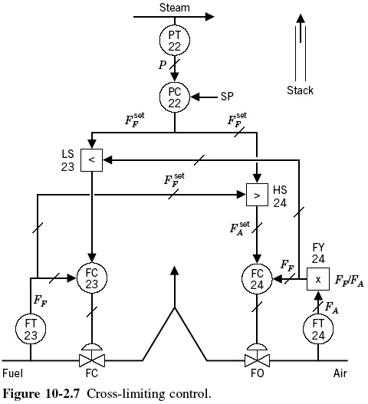
Example 2: Air/Fuel Ratio
Fig. 6
Only two selectors, LS23 and HS24, are added to the previous control scheme. The selectors provide a way to decide which device sets the set point to the controller.

Slide 17
Example 2: Air/Fuel Ratio
Because the amount of excess air is so important in operation of boilers, it has been proposed that some feedback signal based on an analysis of the stack gases be provided; the analysis is usually percent O₂, or CO.
It is proposed that the fuel/air ratio then be adjusted on the basis of this analysis. This new scheme, which is shown in Fig. 7, consists of an analyzer transmitter, AT25, and a controller, AC25. The controller maintains the required percent O₂, for example, in the stack gases by setting the required fuel/air ratio. The figure shows the use of high and low limiters, HL26 and LL27. These two units are used mainly for safety reasons. They ensure that the air/fuel ratio will always be between some preset high and low values.

Slide 18
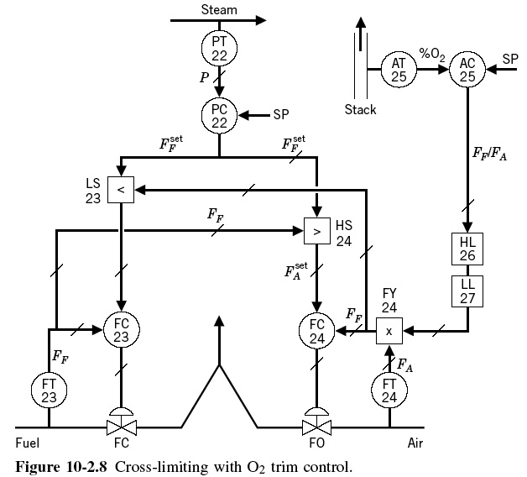
Example 2: Air/Fuel Ratio
Fig. 7

Slide 19
Constraint Control
Constraint or override control is a powerful yet simple control strategy generally used as a protective strategy to maintain process variables within limits that must be enforced to ensure the safety of personnel and equipment and product quality.
As a protective strategy, override control is not as drastic as interlock control. Interlock controls are used primarily to protect against equipment malfunction. When a malfunction is detected, the interlock system usually shuts the process down.
Two examples of constraint control are now presented to demonstrate the concept and implementation of the strategy.

Slide 20
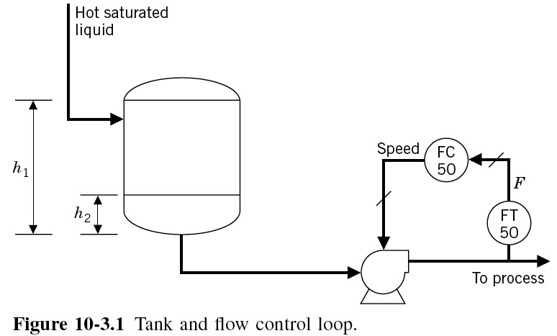
Example 3: Hot Liquid Tank
A hot saturated liquid enters a tank and from there is pumped under flow control back to the process. Under normal operation the level in the tank is at height h₁. If, under any circumstances, the liquid level drops below the height h₂, the liquid will not have enough net positive suction head (NPSH), and cavitation at the pump will result. It is therefore necessary to design a control scheme that avoids this condition.
Fig. 8

Slide 21
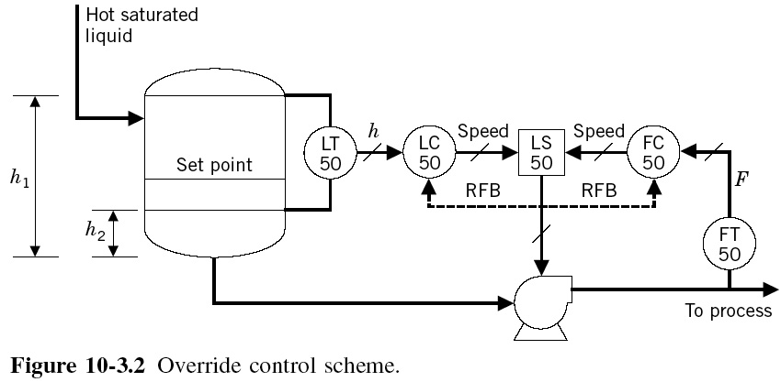
Example 3: Hot Liquid Tank
Under normal operating conditions the level is at h₁, which is above the set point to the level controller; consequently, the controller will try to speed up the pump as much as possible, increasing its output to 100%, but the low selector selects the flow controller signal to manipulate the pump speed.
Fig. 9

Slide 22
Example 3: Hot Liquid Tank
Now suppose that the flow of hot saturated liquid into the tank slows down and the level starts to drop. As soon as the level drops below the set point, the LC50 will try to slow down the pump by reducing its output. When the LC50 output drops below the FC50 output, the LS50 selects the output of LC50 to manipulate the pump.
Fig. 9

Slide 23
Example 3: Hot Liquid Tank
When the flow of hot liquid returns to its normal value, and the level increases above the set point, the LC50 increases its output to speed up the pump. Once the output from the LC50 increases above the output from the FC50, the LS50 selects the FC50 output, and operation returns to its normal condition.
Fig. 9

Slide 24
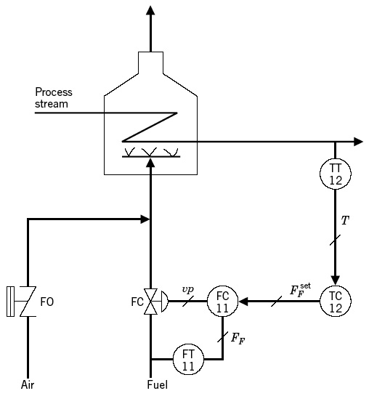
Example 4: Furnace or Fired Heater
There are several conditions in this heater that can prove quite hazardous. a) High fuel pressure, which can sustain a stable flame, and b) High stack, or tube, temperature than the equipment can safely handle. If either of these conditions exist, the gas fuel flow must decrease to avoid the unsafe condition.
Fig. 10

Slide 25
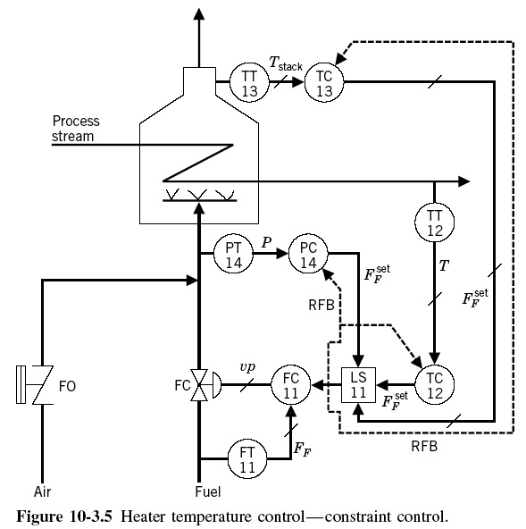
Example 4: Furnace or Fired Heater
The gas fuel pressure is usually below the set point to PC14, and consequently, the controller will try to raise the set point to the fuel flow controller. The stack temperature will also usually be below the set point to TC13, and consequently, the controller will try to raise the set point to the fuel flow controller.
Fig. 11

Slide 26
Example 4: Furnace or Fired Heater
Thus, under normal conditions the exit heater temperature controller would be the controller selected by the low selector because its output will be the lowest of the three controllers. Only when one of the unsafe conditions exist would TC12 be “overridden” by one of the other controllers.
Fig. 11

Slide 27
Example 4: Furnace or Fired Heater
The constraint control scheme shown in Fig. 11 contains a possible safety difficulty. If at any time the operator were to set the flow controller FC11 in local set point or in the manual mode, the safety provided by TC13 and PC14 would not be in effect. This would result in an unsafe operating condition.
What is a new constraint control strategy to solve this problem?
Fig. 11

