Slide 1
Two Phase Pipeline Part I
Ref.1 : Brill & Beggs, Two Phase Flow in Pipes, 6th Edition, 1991. Chapter 1 & 3.
Ref.2: Mokhatab et al, Handbook of Natural Gas Transmission and Processing, Gulf Publishing Com., 2006, Chapter 3.

Slide 2
Two-Phase Flow Properties Holdup
1- Liquid and Gas Holdup (H_{L} & H_{g}): H_{L} is defined as the ratio of the volume of a pipe segment occupied by liquid to the volume of the pipe segment. The remainder of the pipe segment is of course occupied by gas, which is referred to as H_{g}. H_{g} = 1 – H_{L}
2- No-Slip Liquid and Gas Holdup (λ_{L} & λ_{g}): λ_{L} is defined as the ratio of the volume of the liquid in a pipe segment divided by the volume of the pipe segment which would exist if the gas and liquid travelled at the same velocity (no-slippage). It can be calculated directly from the known gas and liquid volumetric flow rates from :

Slide 3
Two-Phase Flow Properties Density
1- Liquid Density (ρ_{L}): ρ_{L} may be calculated from the oil and water densities with assumption of no slippage between the oil and water phases as follows:
2- Two-Phase Density: Calculation of the two-phase density requires knowledge of the liquid holdup. Three equations for two-phase density are used by various investigators in two-phase flow:

Slide 4
Two-Phase Flow Properties Velocity
1- Superficial Gas and Liquid Velocities (v_{sg} & v_{sL}):
2- Actual Gas and Liquid Velocities (v_{g} & v_{L}):
3- Two-Phase Velocity (v_{m}):
4- Slip Velocity (v_{s}):

Slide 5
Two-Phase Flow Properties Viscosity
1- Liquid Viscosity (μ_{L}): μ_{L} may be calculated from the oil and water viscosities with assumption of no slippage between the oil and water phases as follows:
2- Two-Phase Viscosity: Calculation of the two-phase viscosity requires knowledge of the liquid holdup. Two equations for two-phase viscosity are used by various investigators in two-phase flow:
3- Liquid Surface Tension (σ_{L}):

Slide 6
Two-Phase Flow Regimes Horizontal Flow
Two-phase flow regimes for horizontal flow are shown in Figure 3-1. These horizontal flow regimes are defined as follows.
Stratified (Smooth and Wavy) Flow: Stratified flow consists of two superposed layers of gas and liquid, formed by segregation under the influence of gravity.
Intermittent (Slug and Elongated Bubble) Flow: The intermittent flow regime is usually divided into two subregimes: plug or elongated bubble flow and slug flow. The elongated bubble flow regime can be considered as a limiting case of slug flow, where the liquid slug is free of entrained gas bubbles. Gas–liquid intermittent flow exists in the whole range of pipe inclinations and over a wide range of gas and liquid flow rates.

Slide 7
Two-Phase Flow Regimes Horizontal Flow
Annular-Mist Flow: During annular flow, the liquid phase flows largely as an annular film on the wall with gas flowing as a central core. Some of the liquid is entrained as droplets in this gas core (mist flow).
Dispersed Bubble Flow: At high liquid rates and low gas rates, the gas is dispersed as bubbles in a continuous liquid phase. The bubble density is higher toward the top of the pipeline, but there are bubbles throughout the cross section. Dispersed flow occurs only at high flow rates and high pressures. This type of flow, which entails high-pressure loss, is rarely encountered in flow lines.
Note that raw gas pipelines usually have stratified flow patterns. In other words, raw gas lines are “sized” to be operated in stratified flow during normal operation.

Slide 8
Two-Phase Flow Regimes Vertical-Upward Flow
Flow regimes frequently encountered in upward vertical two-phase flow are shown in Figure 3-2.These regimes are defined as follows.
Bubble Flow: The gas phase is distributed in the liquid phase as variable-size, deformable bubbles moving upward with zigzag motion. The wall of the pipe is always contacted by the liquid phase.
Slug Flow: Most of the gas is in the form of large bullet-shaped bubbles that have a diameter almost reaching the pipe diameter. These bubbles are referred to as “Taylor bubbles,” move uniformly upward, and are separated by slugs of continuous liquid that bridge the pipe and contain small gas bubbles. The gas bubble velocity is greater than that of the liquid.

Slide 9
Two-Phase Flow Regimes Vertical-Upward Flow
Churn Flow: If a change from a continuous liquid phase to a continuous gas phase occurs, the continuity of the liquid in the slug between successive Taylor bubbles is destroyed repeatedly by a high local gas concentration in the slug. This oscillatory flow of the liquid is typical of churn flow. It may not occur in small-diameter pipes. The gas bubbles may join and liquid may be entrained in the bubbles.
Annular-Mist Flow: Annular flow is characterized by the continuity of the gas phase in the pipe core. The liquid phase moves upward partly as a wavy film and partly in the form of drops entrained in the gas core.
Reliable models for downward multiphase flow are currently unavailable and the design codes are deficient in this area.

Slide 10
Two-Phase Flow Regimes Inclined Flow
Pipe inclination angles have a very strong influence on flow pattern transitions.
Generally, the flow regime in a near-horizontal pipe remains segregated for downward inclinations and changes to an intermittent flow regime for upward inclinations.
An intermittent flow regime remains intermittent when tilted upward and tends to segregated flow pattern when inclined downward.
The inclination should not significantly affect the distributed flow regime.

Slide 11
Two-Phase Flow Correlations General Equation
General Pressure Gradient Equation: The pressure gradient equation which is applicable to any fluid flowing in a pipe inclined at an angle φ from horizontal was derived previously. This equation is usually adapted for two-phase flow by assuming that the two-phase flow regime and two-phase properties can be considered homogeneous over a finite volume of the pipe.
Depend on the using correlation

Slide 12
Two-Phase Flow Correlations General Equation
Many correlations have been developed for predicting two-phase flow pressure gradients which differ in the manner used to calculate the three terms of pressure gradients equation (elevation change, friction and acceleration terms):
a. No slip, no flow regime considerations: the mixture density is calculated based on the no slip holdup. No distinction is made for different flow regimes.
b. Slip considered, no flow regime consideration: The same correlations for liquid holdup and friction factor are used for all flow regimes.
c. Slip considered, flow regime considered: Usually a different liquid holdup and friction factor prediction methods are required in each flow regimes.

Slide 13
Two-Phase Flow Procedure for Outlet Pressure Calculation
1. Starting with the known inlet pressure and flow rates.
2. Select a length increment, ΔL, and estimate the pressure drop in this increment, ΔP.
3. Calculate the average pressure and, for non-isothermal cases, the average temperature in the increment.
4. Determine the gas and liquid properties (based on black-oil or compositional model) at average pressure and temperature conditions.
5. Calculate the pressure gradient, dP/dL, in the increment at average conditions of pressure, temperature, and pipe inclination, using the appropriate pressure gradient correlation.
6. Calculate the pressure drop in the selected length increment, ΔP=ΔL(-dP/dL).
7. Compare the estimated and calculated values of ΔP. If they are not sufficiently close, estimate a new value and return to step 3.
8. Repeat the steps 2 to 7 for the next pipe length increment.

Slide 14
Two-Phase Flow Correlations Vertical Upward Flow Pipeline
The vertical flow correlations discussed in this section and the category in which they belong are listed below:
Correlation | Category
Poettmann and Carpenter | a
Baxendell and Thomas | a
Fancher and Brown | a
Hagedorn and Brown | b
Duns and Ros | c
Orkiszewski | c
Aziz, Govier and Fogarasi | c
Chierici, Ciucci and Sclocehi | c
Beggs and Brill | c

Slide 15
Two-Phase Flow Correlations Vertical-Upward Flow (Category a)
The basic equation for calculating a pressure gradient in the three correlations considered in this category is:
In each method the two-phase friction factor ( f_{tp} ) was correlated empirically with the numerator of the Reynolds number ( ρ_{n} v_{m} d ):
1- Poettmann and Carpenter : Figure 3-3
2- Baxendell and Thomas: Figure 3-4
3- Fancher and Brown: Figure 3-5

Slide 16
Two-Phase Flow Correlations Vertical-Upward Flow (Category b)
The only correlation discussed in this category (b) is that of Hagedorn and Brown. The liquid holdup predicted by this method is not a true value, it is only a correlating parameter for calculating the pressure gradient. The four dimensionless numbers used in Hagedorn and Brown method are:
Liquid Velocity Number:
Gas Velocity Number:
Pipe Diameter Number:
Liquid Viscosity Number:
ft/sec
lb_{m}/ft³
ft
dynes/cm
cp

Slide 17
Two-Phase Flow Correlations Vertical-Upward Flow (Category b)
The steps for calculating the Liquid holdup are:
1- Calculate CN_{L} from Figure 3-6.
2- Calculate the liquid holdup factor (H_{L}/ψ) from Figure 3-7.
3- Calculate the correction factor, ψ, from Figure 3-8.
The steps for calculating the two-phase friction factor are:
1- Calculate the two-phase Reynold number:
2- Calculate the f_{tp} from Moody diagram (Figure 3-9).

Slide 18
Two-Phase Flow Correlations Vertical-Upward Flow (Category b)
The pressure gradients in Hagedorn and Brown method can be calculated as follows:
Where:

Slide 19
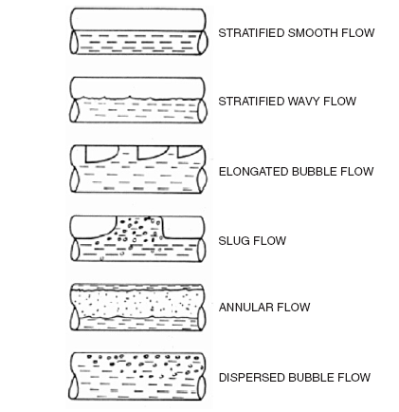
Figure 3-1. Horizontal two-phase flow regimes (Cindric et al., 1987).

Slide 20
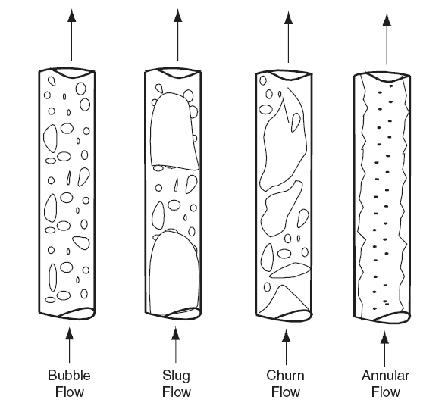
Figure 3-2. Upward vertical two-phase flow regimes (Shoham, 1982).

Slide 21
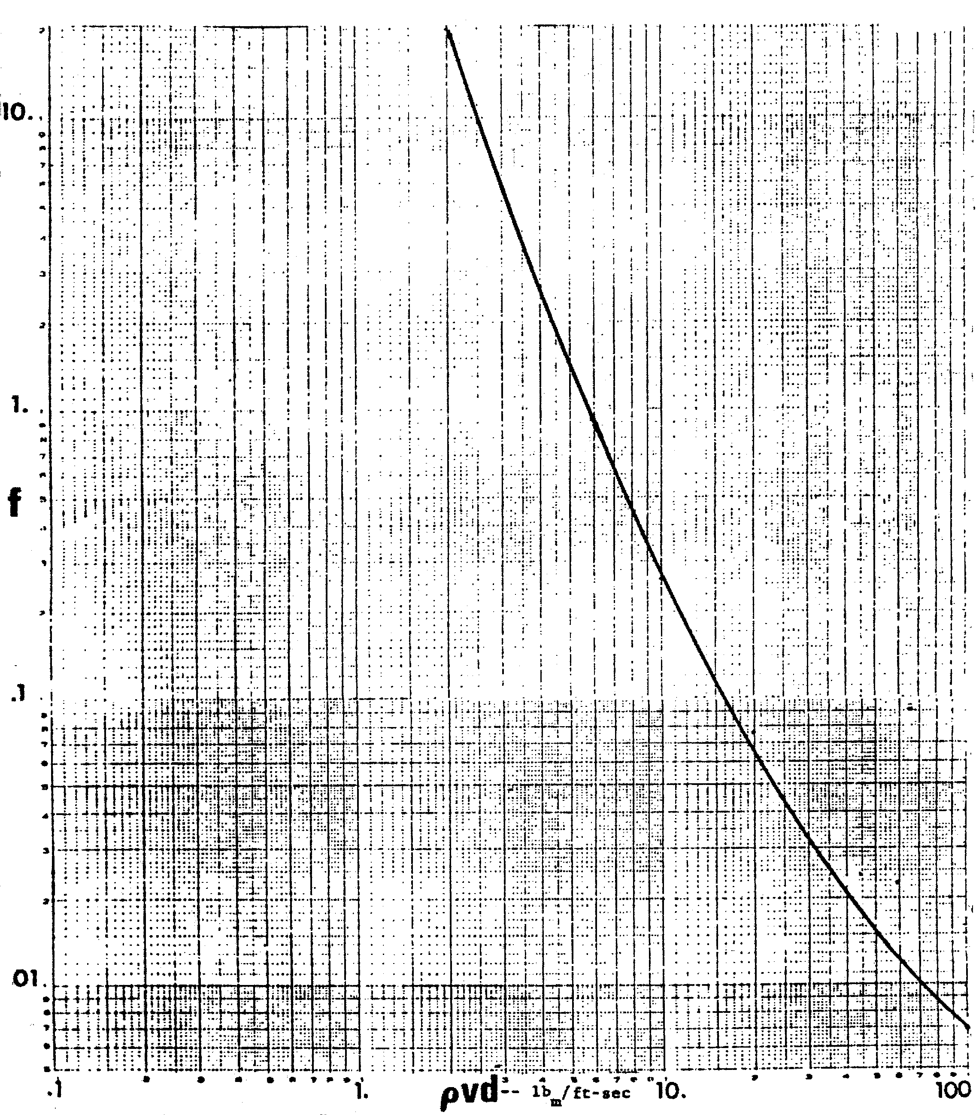
Figure 3-3. Poettmann and Carpenter friction factor correlation.

Slide 22
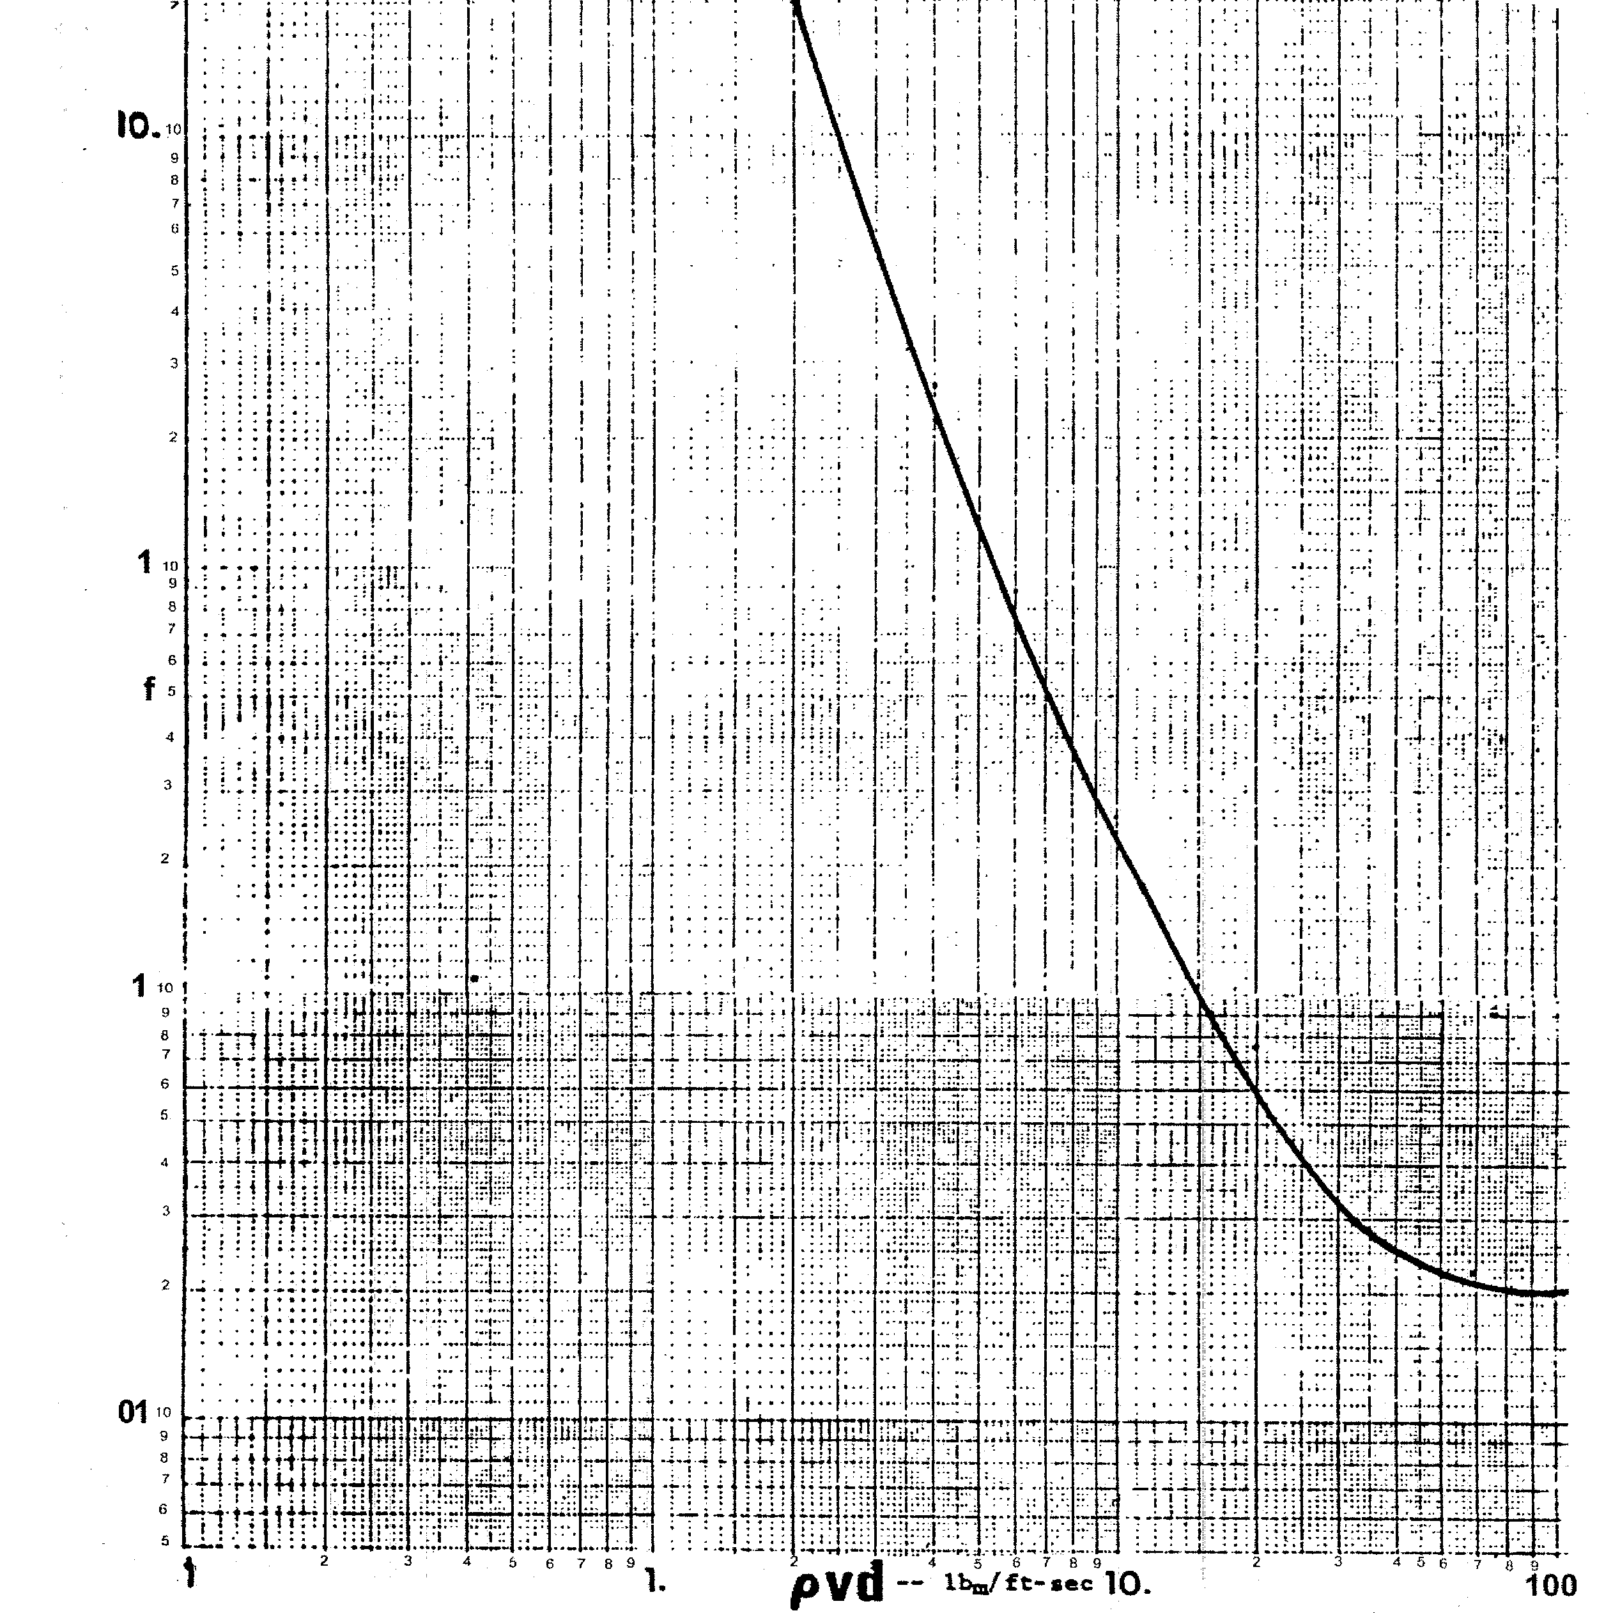
Figure 3-4. Baxendell and Thomas friction factor correlation.

Slide 23
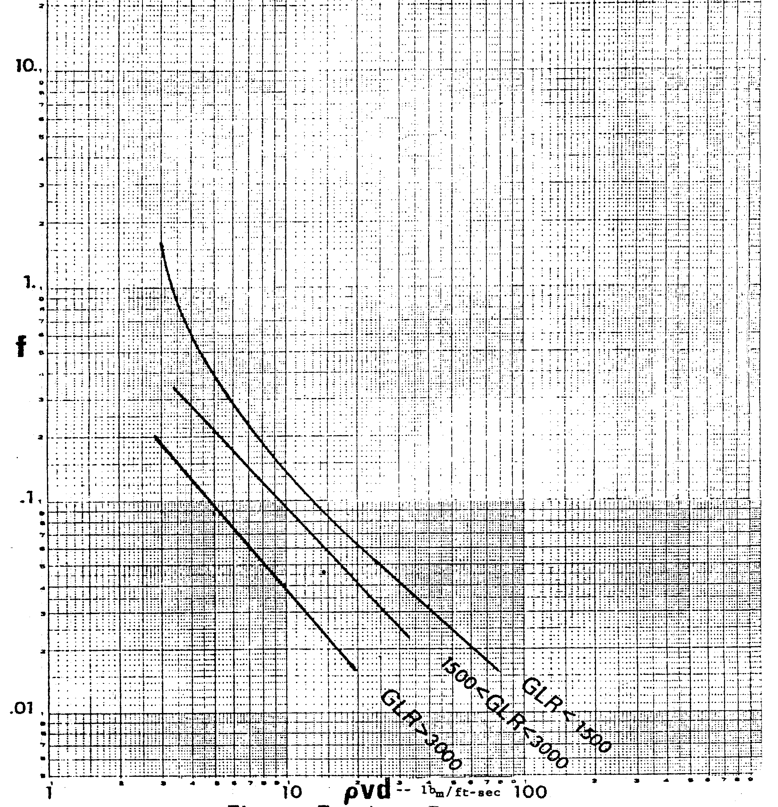
Figure 3-5. Fancher and Brown friction factor correlation.

Slide 24
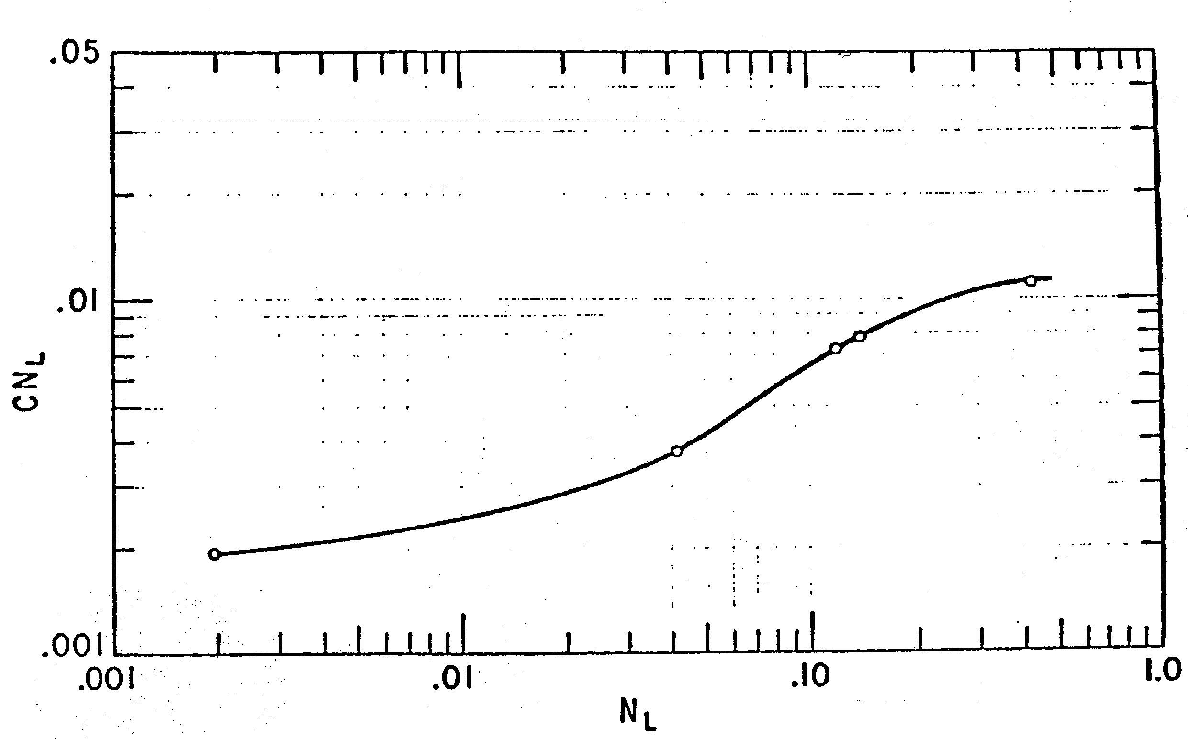
Figure 3-6. Correlating parameter, CN_{L}.

Slide 25
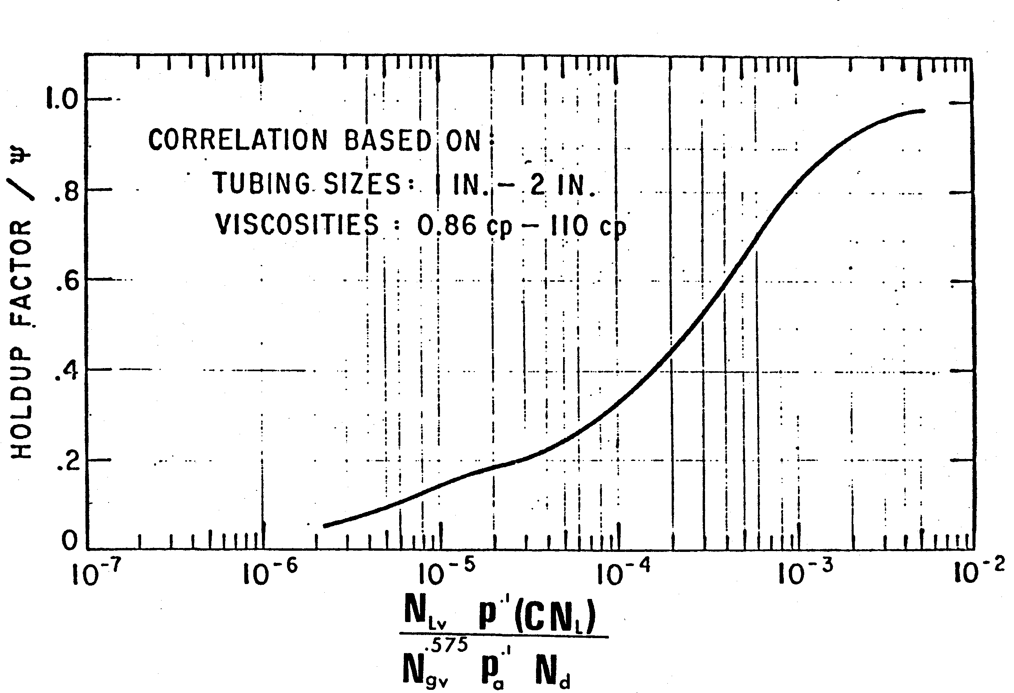
Figure 3-7. Liquid holdup factor correlation, P_{a}=base pressure (14.7 psia).

Slide 26
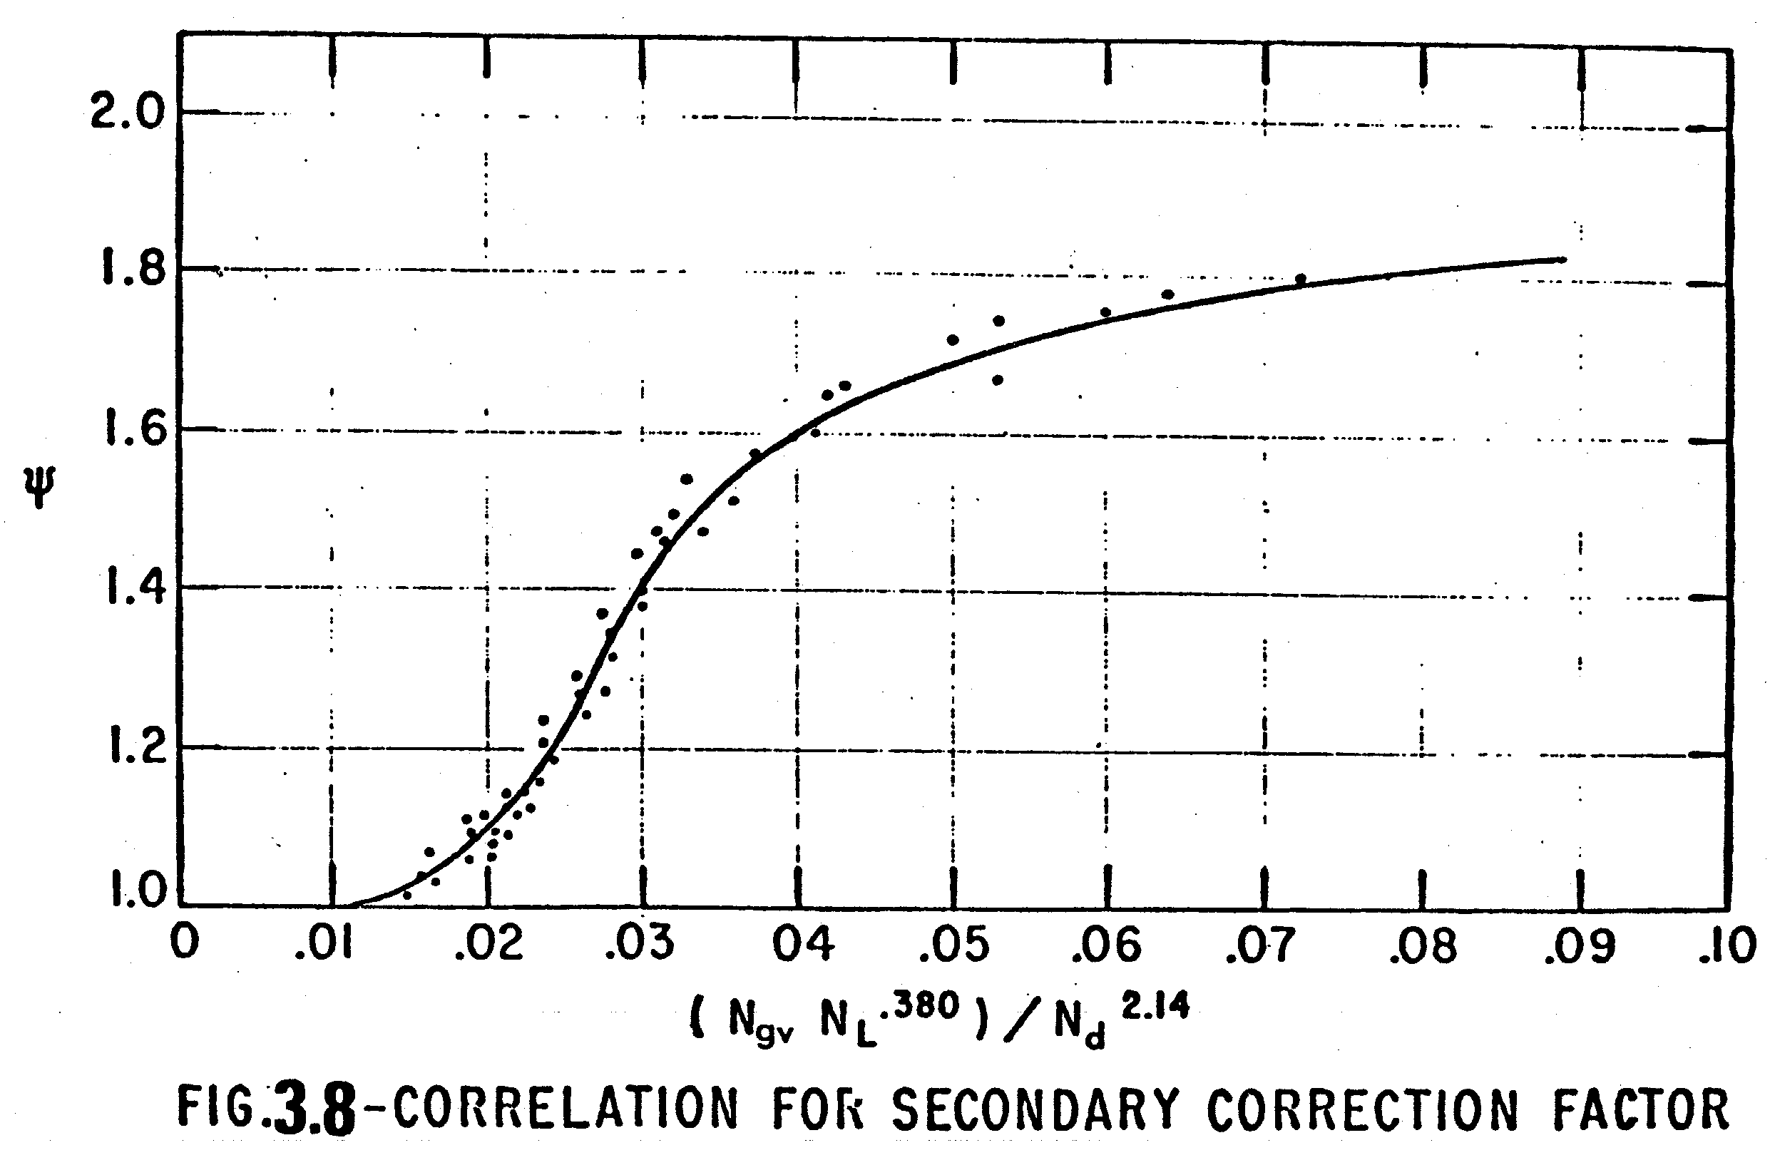
Figure 3-8. Correlation of second correction factor, ψ

Slide 27
