Slide 1
Two Phase Pipeline Part II
Ref.: Brill & Beggs, Two Phase Flow in Pipes, 6th Edition, 1991. Chapter 3.

Slide 2
Two-Phase Flow Correlations Vertical Upward Flow Pipeline (Duns & Ros)
1- Flow regimes boundaries: The flow regimes map is shown in Figure 3-10. The flow regimes boundaries are defined as a functions of the dimensionless quantities: N_{gv}, N_{Lv}, N_{d}, N_{L}, L₁, L₂, L_{s} and L_{m} where:
N_{gv}, N_{Lv}, N_{d} and N_{L} are the same as Hagedorn & Brown method.
L_{s}= 50 + 36 N_{Lv} and L_{m}= 75 + 84 N_{Lv}^{0.75}
L₁ and L₂ are functions of N_{d} as shown in Figure 3-11.
Bubble Flow Limits: 0 ≤ N_{gv} ≤ L₁ + L₂ N_{Lv}
Slug Flow Limits: L₁ + L₂ N_{Lv} ≤ N_{gv} ≤ L_{s}
Transition (Churn) Flow Limits: L_{s} < N_{gv} <L_{m}
Annular-Mist Flow Limits: N_{gv} > L_{m}

Slide 3
Two-Phase Flow Correlations Vertical Upward Flow Pipeline (Duns & Ros)
2- Pressure gradient due to elevation change: The procedure for calculating the pressure gradient due to elevation change in each flow regimes is:
Calculate the dimensionless slip velocity (S) based on the appropriate correlation
Calculate v_{s} based on the definition of S:
Calculate H_{L} based on the definition of v_{s} :
Calculate the pressure gradient due to elevation change:

Slide 4
Two-Phase Flow Correlations Vertical Upward Flow Pipeline (Duns & Ros)
Correlations for calculating S in each flow regimes:
Bubble Flow:
F₁ , F₂ , F₃ and F₄ can be obtained from Figure 3-12.
Slug Flow:
F₅ , F₆ and F₇ can be obtained from Figure 3-14.
Mist Flow: Duns and Ros assumed that with the high gas flow rates in the mist flow region the slip velocity was zero (ρ_{s}= ρ_{n}).

Slide 5
Two-Phase Flow Correlations Vertical Upward Flow Pipeline (Duns & Ros)
3- Pressure gradient due to friction:
Bubble Flow:
f₁ is obtained from Moody diagram ( ), f₂ is a correction for the gas-liquid ratio, and is given in Figure 3-13, and f₃ is an additional correction factor for both liquid viscosity and gas-liquid ratio, and can be calculated as:
Slug Flow: The same as bubble flow regime.

Slide 6
Two-Phase Flow Correlations Vertical Upward Flow Pipeline (Duns & Ros)
Annular-Mist Flow: In this region, the friction term is based on the gas phase only. Thus:
As the wave height on the pipe walls increase, the actual area through which the gas can flow is decreased, since the diameter open to gas is d – ε.
After calculating the gas Reynolds number, , the two-phase friction factor can be obtained from Moody diagram or rough pipe equation:

Slide 7
Two-Phase Flow Correlations Vertical Upward Flow Pipeline (Duns & Ros)
Duns and Ros noted that the wall roughness for mist flow is affected by the wall liquid film. Its value is greater than the pipe roughness and less than 0.5, and can be calculated as follows (or Figure 3-15):
Where
Duns and Ros suggested that the prediction of friction loss could be refined by using d – ε instead of d. In this case the determination of roughness is iterative.

Slide 8
Two-Phase Flow Correlations Vertical Upward Flow Pipeline (Duns & Ros)
4- Pressure gradient due to acceleration:
Bubble Flow: The acceleration term is negligible.
Slug Flow: The acceleration term is negligible.
Mist Flow:

Slide 9
Two-Phase Flow Correlations Vertical Upward Flow Pipeline (Duns & Ros)
Transition Flow: In the transition zone between slug and mist flow, Duns and Ros suggested linear interpolation between the flow regime boundaries, L_{s} and L_{m} , to obtain the pressure gradient, as follows:
Where
Increased accuracy was claimed if the gas density used in the mist flow pressure gradient calculation was modified to :

Slide 10
Two-Phase Flow Correlations Vertical Upward Flow Pipeline (Orkiszewski)
Orkiszewski, after testing several correlations, selected the Griffith and Wallis method for bubble flow and the Duns and Ros method for annular-mist flow. For slug flow, he proposed a new correlation.
Bubble Flow
1- Limits: v_{sg} / v_{m} < L_{B}
2- Liquid Holdup:
Where the v_{s} have a constant value of 0.8 ft/sec.

Slide 11
Two-Phase Flow Correlations Vertical Upward Flow Pipeline (Orkiszewski)
3- Pressure gradient due to friction:
Where f_{tp} is obtained from Moody diagram with liquid Reynolds number:
4- Pressure gradient due to acceleration: is negligible in bubble flow regimes.
Slug Flow
1- Limits: v_{sg} / v_{m} > L_{B} and N_{gv} < L_{s}
Where L_{s} and N_{gv} are the same as Duns and Ros method.

Slide 12
Two-Phase Flow Correlations Vertical Upward Flow Pipeline (Orkiszewski)
2- Two-phase density:
The following procedure must be used for calculating v_{b}:
1- Estimate a value for v_{b}. A good guess is v_{b} = 0.5 (g d)^{0.5}
2- Based on the value of v_{b} , calculate the
3- Calculate the new value of v_{b} from the equations shown in the next page, based on N_{Reb} and N_{ReL} where
4- Compare the values of v_{b} obtained in steps one and three. If they are not sufficiently close, use the values calculated in step three as the next guess and go to step two.

Slide 13
Two-Phase Flow Correlations Vertical Upward Flow Pipeline (Orkiszewski)
Use the following equations for calculation of v_{b}:

Slide 14
Two-Phase Flow Correlations Vertical Upward Flow Pipeline (Orkiszewski)
The value of δ can be calculated from the following equations depending upon the continuous liquid phase and mixture velocity.
Continuous Liquid Phase | Value of v_{m} | Equation of δ
Water | < 10
Water | >10
Oil | <10
Oil | >10

Slide 15
Two-Phase Flow Correlations Vertical Upward Flow Pipeline (Orkiszewski)
Data from literature indicate that a phase inversion from oil continuous to water continuous occurs at a water cut of approximately 75% in emulsion flow.
The value of δ is constrained by the following limits:
These constraints are supposed to eliminate pressure discontinuities between equations for δ since the equation pairs do not necessarily meet at v_{m}=10 ft/sec.

Slide 16
Two-Phase Flow Correlations Vertical Upward Flow Pipeline (Orkiszewski)
3- Pressure gradient due to friction:
Where f_{tp} is obtained from Moody diagram with mixture Reynolds number:
4- Pressure gradient due to acceleration: is negligible in slug flow regime.
Transition (Churn) Flow Limits: L_{s} < N_{gv} <L_{m}
The same as Duns and Ros method.
Annular-Mist Flow Limits: N_{gv} > L_{m}
The same as Duns and Ros method.

Slide 17
Two-Phase Flow Correlations Beggs and Brill
Beggs and Brill method can be used for vertical, horizontal and inclined two-phase flow pipelines.
1- Flow Regimes: The flow regime used in this method is a correlating parameter and gives no information about the actual flow regime unless the pipe is horizontal.
The flow regime map is shown in Figure 3-16. The flow regimes boundaries are defined as a functions of the following variables:

Slide 18
Two-Phase Flow Correlations Beggs and Brill
Segregated Limits:
Transition Limits:
Intermittent Limits:
Distributed Limits:

Slide 19
Two-Phase Flow Correlations Beggs and Brill
2- Liquid Holdup: In all flow regimes, except transition, liquid holdup can be calculated from the following equation:
Where H_{L(0)} is the liquid holdup which would exist at the same conditions in a horizontal pipe. The values of parameters, a, b and c are shown for each flow regimes in this Table:
For transition flow regimes, calculate H_{L} as follows:
Flow Pattern | a | b | c
Segregated | 0.98 | 0.4846 | 0.0868
Intermittent | 0.845 | 0.5351 | 0.0173
Distributed | 1.065 | 0.5824 | 0.0609

Slide 20
Two-Phase Flow Correlations Beggs and Brill
The holdup correcting factor (ψ), for the effect of pipe inclination is given by:
Where φ is the actual angle of the pipe from horizontal. For vertical upward flow, φ = 90º and ψ = 1 + 0.3 C. C is:
The values of parameters, d’, e, f and g are shown for each flow regimes in this Table:
Flow Pattern | d' | e | f | g
Segregated uphill | 0.011 | -3.768 | 3.539 | -1.614
Intermittent uphill | 2.96 | 0.305 | -0.4473 | 0.0978
Distributed uphill | No correction C = 0 , ψ = 1
All patterns downhill | 4.70 | -0.3692 | 0.1244 | -0.5056

Slide 21
Two-Phase Flow Correlations Beggs and Brill
3- Pressure gradient due to friction factor:
f_{n} is determined from the smooth pipe curve of the Moody diagram, using the following Reynolds number:
The parameter S can be calculated as follows:
For and for others:

Slide 22
Two-Phase Flow Correlations Beggs and Brill
4- Pressure gradient due to acceleration: Although the acceleration term is very small except for high velocity flow, it should be included for increased accuracy.

Slide 23
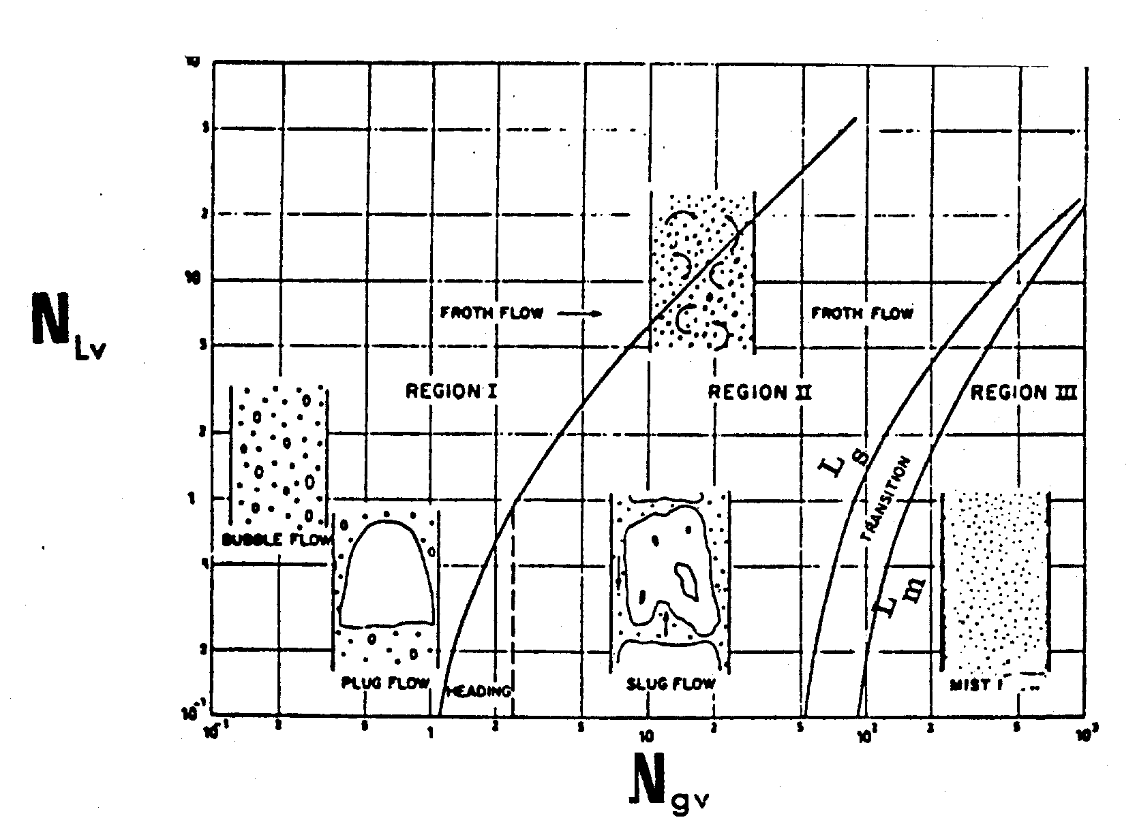
Figure 3-10. Vertical two-phase flow regimes map (Duns & Ros).

Slide 24
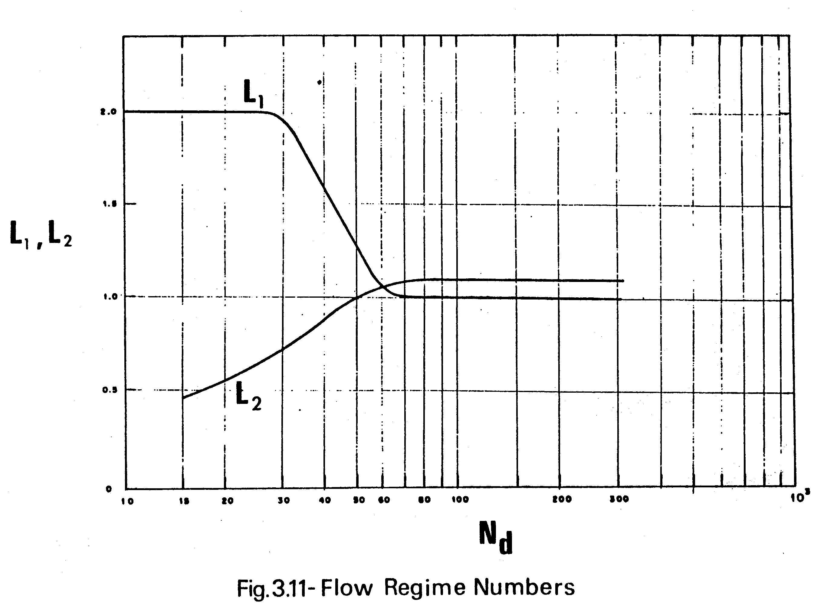

Slide 25
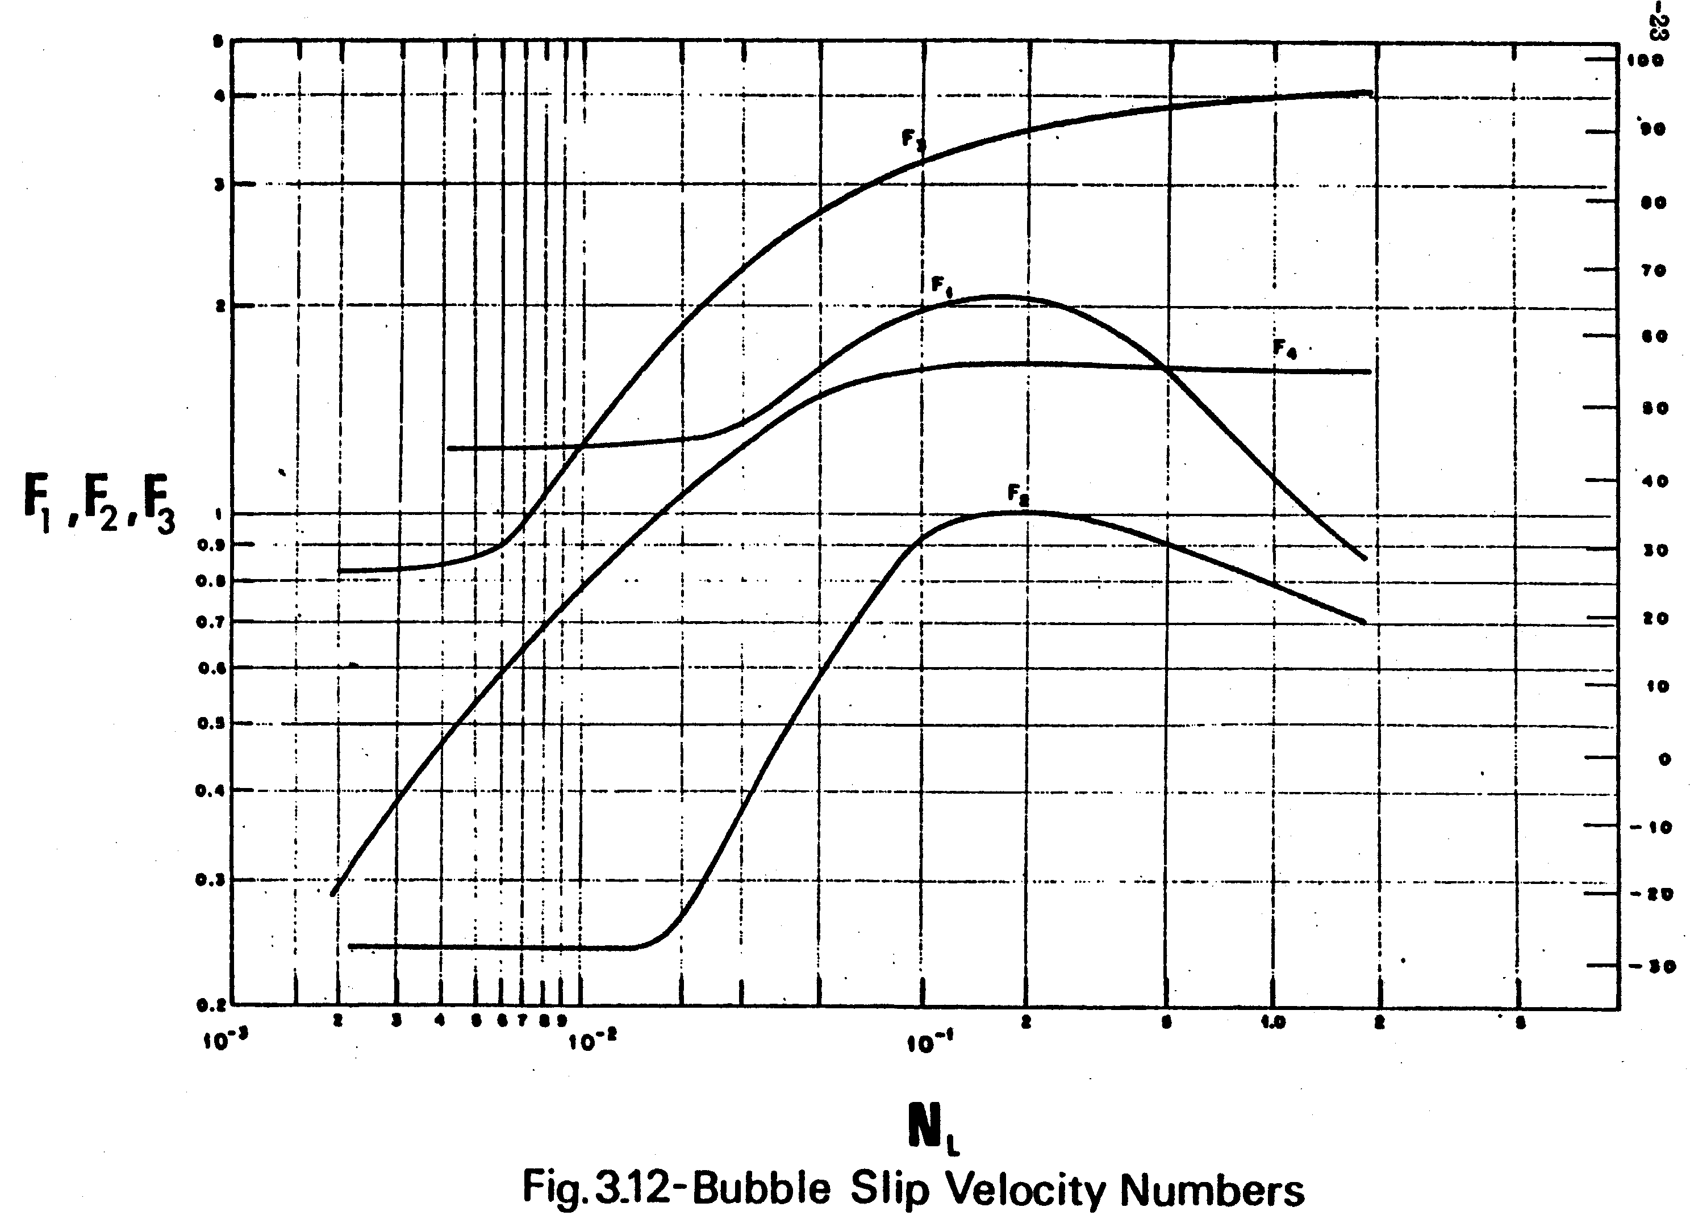
F₃
F₄
F₂
F₄

Slide 26
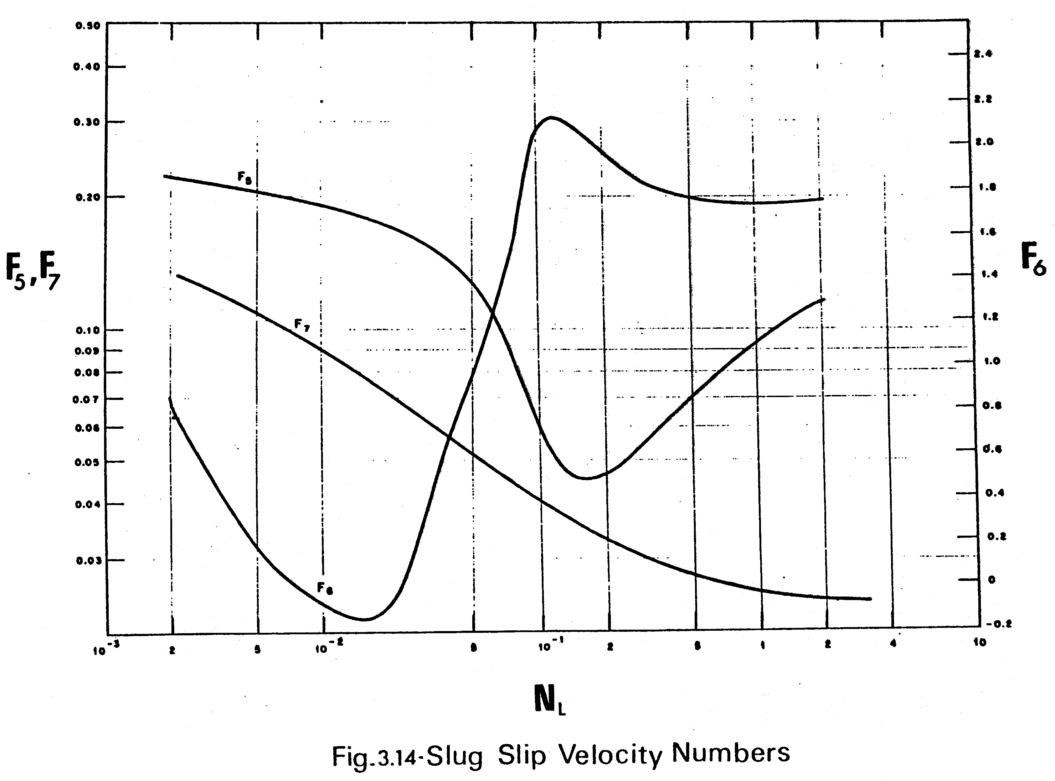
F₅
F₆

Slide 27
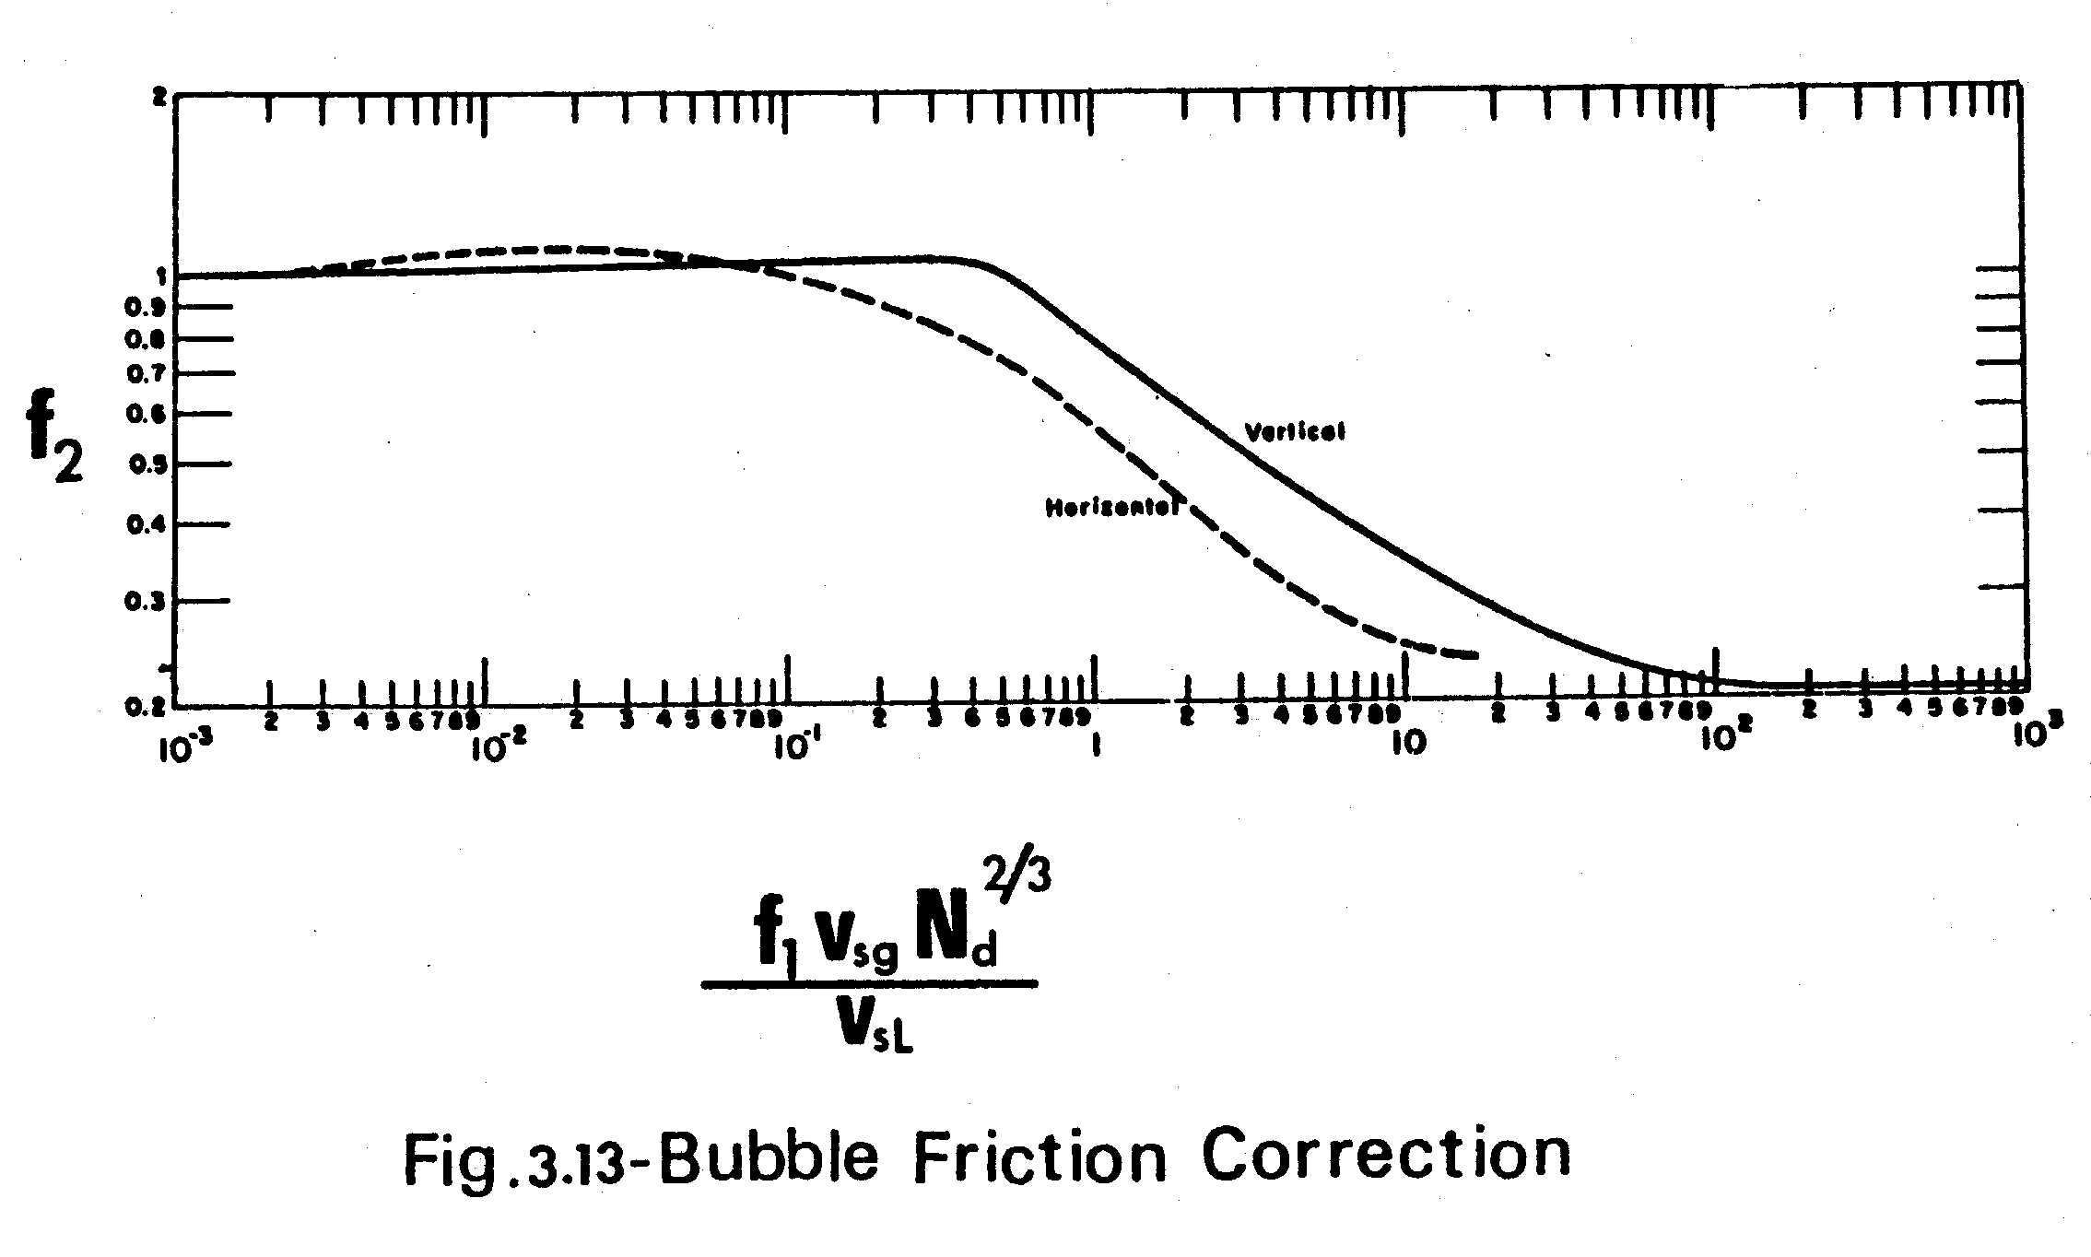

Slide 28
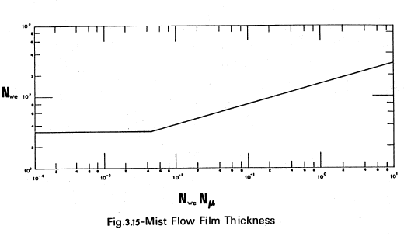

Slide 29
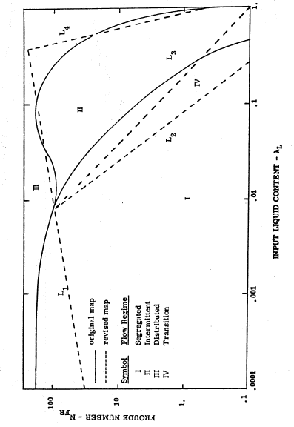
Figure 3-16. Beggs and Brill, Horizontal flow regimes map.

